Slide 1
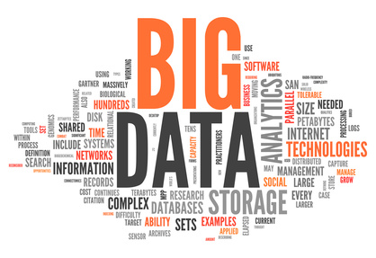
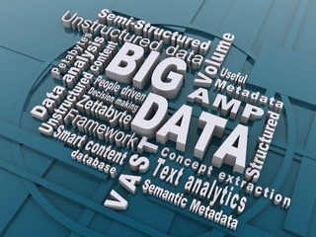
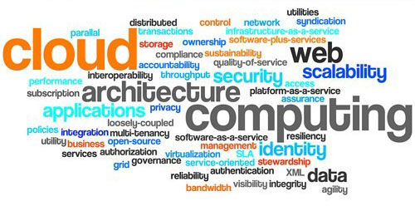

Big Data Infrastructure and Technologies Lecture #1 Big Data Infrastructure and Cloud based solutions for Big Data by AWS, Microsoft Azure, Google
Yuri Demchenko, UvA
CN
CN
CN
CN
CN
CN
CN
CN
CN
CN
CN

Slide 2

Outline
Definitions
Big Data, Cloud Computing, Data Science
Standardisation
NIST, CSA, DMTF, IDS, RDA, DAMA. IEEE
Big Data platforms and tools
Big Data Storage, SQL and NoSQL, modern databases
Apache Hadoop Ecosystem
AWS, Google Cloud Platform, Azure
DevOps and DataOps
Cloud automation and monitoring tools
Azure DevOps services and tools
Optional: Data Markets and Data Exchange
Data properties as economic goods
Discussion
This work is licensed under the Creative Commons Attribution 4.0 International License. To view a copy of this license, visit http://creativecommons.org/licenses/by/4.0/

Slide 3
Yuri Demchenko, Senior Researcher, Lecturer, UvA
Graduated and PhD from National Technical University of Ukraine “Kiev Polytechnic Institute”
University of Amsterdam – since 2003
Research areas
Big Data Infrastructure and Data Science platforms
Cloud architecture, cloud automation and DevOps
Cloud security and compliance
Teaching courses (on campus and online)
Big Data Infrastructure and Technologies
Cloud powered Software Engineering and DevOps
Data Science Foundations, Professional Issues in Data Science
Security Engineering
Recent projects
FAIRsFAIR: FAIR Principles in research data management
MATES: Digitalisation of the European Blue Economy
EDISON: Building the Data Science Profession for Europe
CYCLONE: Multi-cloud automation platform for cloud based applications
GEANT4 Research: Cloud aware networking infrastructure provisioning on-demand

Slide 4
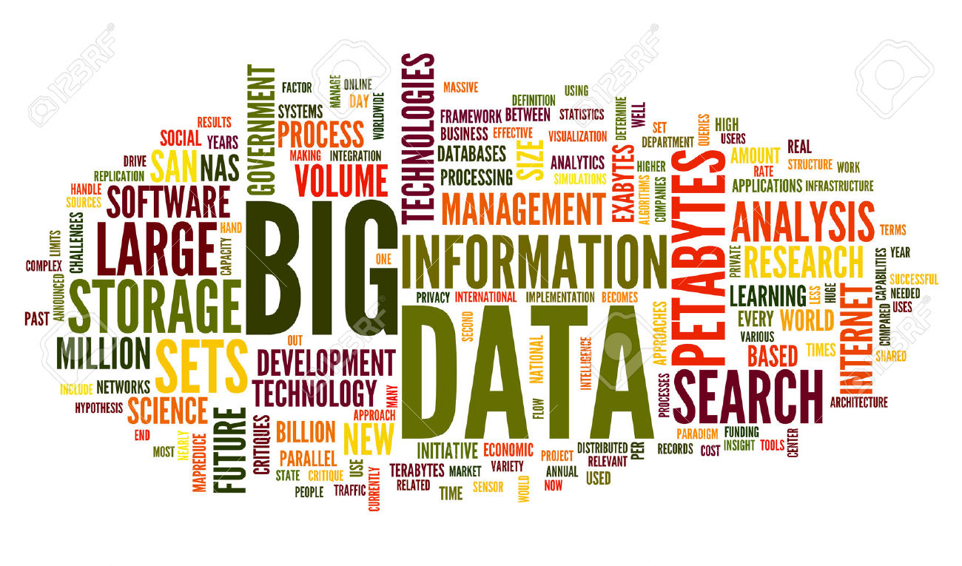
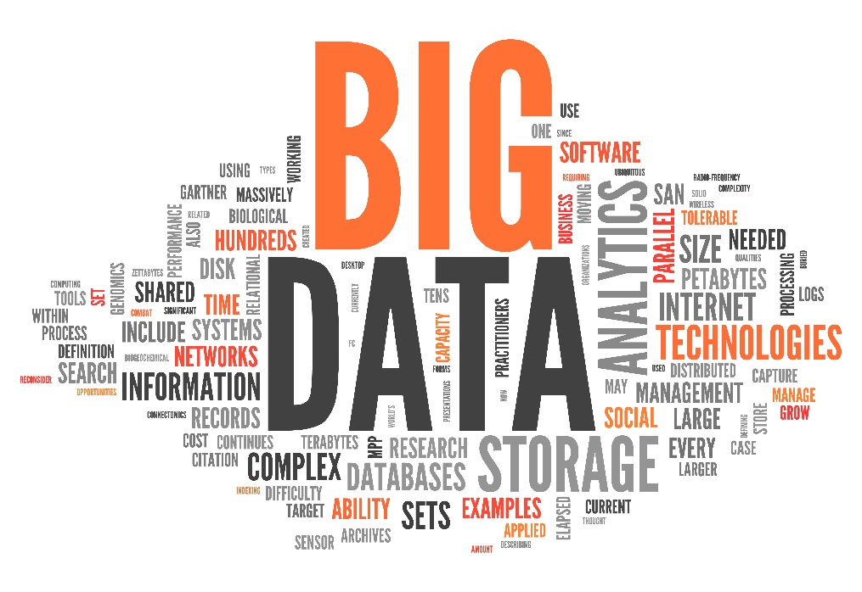
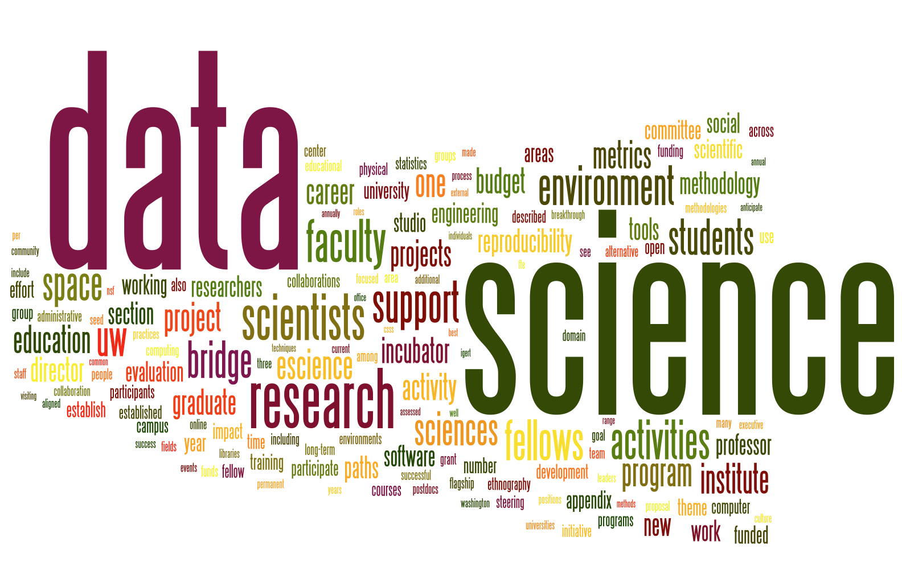
Multiple aspects of Big Data
Big Data is a complex of technologies to enable handling of Big Data (storage, processing, transfer, security)

Slide 5
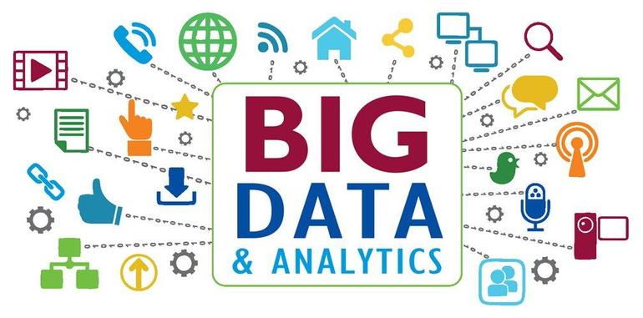
Big Data and multiple sources of data
Social Media
IoT
Internet
Science
Industrial data
Communication, voice
Data analytics blending with open and social media data

Slide 6
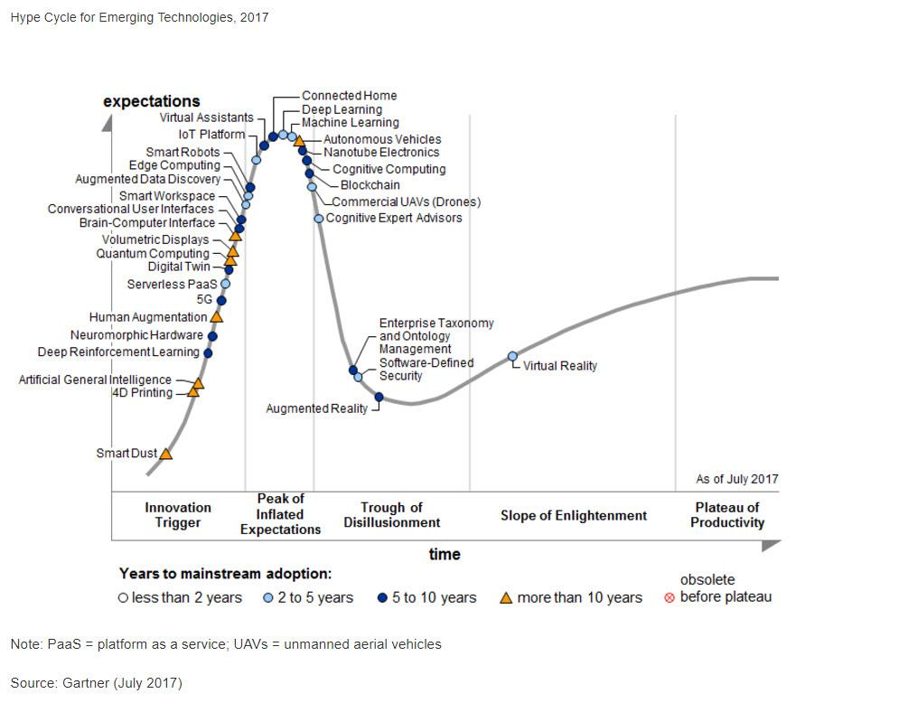
Gartner Technology Hypercycle (August 2017)
Big Data and Cloud Computing:
In a maturity stage –
already commodity services
[ref] https://www.gartner.com/smarterwithgartner/top-trends-in-the-gartner-hype-cycle-for-emerging-technologies-2017/

Slide 7
Gartner Technology Hypercycle (August 2017)
We are in post Big Data and post Cloud Computing stage
Big Data and Cloud Computing:
In a maturity stage –
already commodity services
[ref] https://www.gartner.com/smarterwithgartner/top-trends-in-the-gartner-hype-cycle-for-emerging-technologies-2017/

Slide 8
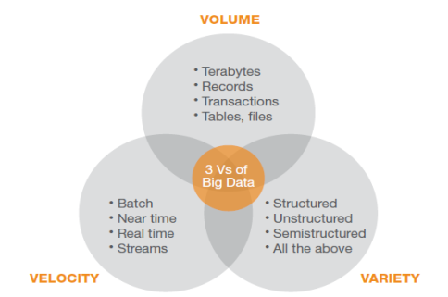
Big Data Properties: 6 (3+3) V’s of Big Data
Volume
Generic Big Data Properties
Volume
Variety
Velocity
Acquired Properties (after entering system)
Value
Veracity
Variability
Terabytes
Records/Arch
Tables, Files
Distributed
Variety
Velocity
Structured
Unstructured
Multi-factor
Probabilistic
Linked
Dynamic
Batch
Real/near-time
Processes
Streams
6 Vs of
Big Data
Changing data
Changing model
Linkage
Value
Correlations
Statistical
Events
Hypothetical
Variability
Trustworthiness
Authenticity
Origin, Reputation
Availability
Accountability
Adopted in general
by NIST Big Data Working
Group (NBD-WG) [ref]
Commonly accepted
3V’s of Big Data
by Gartner [ref]
Veracity
Notes:
It is widely used metaphor to represent Big Data properties as 3V or 5V properties.
We will brig to the Big Data definition more structure approach.
We can admit that the famous 3V of Big Data are generic Big Data properties:
Volume
Variety
Velocity
However the Big Data after entering the system will acquire a number of new properties of which another 3V are commponly accepted
Value
Veracity
Variability
The similar model is proposed in the NIST Big Data standards group published by the NIST Big Data Working
Group (NBD-WG)

Slide 9
Big Data Definition: From 6V to 5 Parts (1)
(1) Big Data Properties: 5V
Volume, Variety, Velocity, Value, Veracity
Additionally: Data Dynamicity (Variability)
(2) New Data Models
Data linking, provenance and referral integrity
Data Lifecycle and Variability/Evolution
(3) New Analytics
Real-time/streaming analytics, interactive and machine learning analytics
(4) New Infrastructure and Tools
High performance Computing, Storage, Network
Heterogeneous multi-provider services integration
New Data Centric (multi-stakeholder) service models
New Data Centric security models for trusted infrastructure and data processing and storage
(5) Source and Target
High velocity/speed data capture from variety of sensors and data sources
Data delivery to different visualisation and actionable systems and consumers
Full digitised input and output, (ubiquitous) sensor networks, full digital control
Notes:
To make better link to the current practice and trends in Big Data technologies and platforms definition we will use/propose the more structured Big Data definition that includes the 5 parts addressing different aspects of the Big Data technology domain.
(1) Big Data Properties: 5V
(2) New Data Models
(3) New Analytics
(4) New Infrastructure and Tools
(5) Source and Target
Importance of including Data Source and Target is explained by the specific of Big Data technologies where technical solutions strongly depend on the data types, data properties collected and the form and method how the data need to delivered to consumer or target system.

Slide 10
Big Data technology drivers - Examples
Modern e-Science in search for new knowledge
Scientific experiments and tools are becoming bigger and heavily based on data processing and mining
Traditional data intensive industry
Genomic research, drugs development, Healthcare
High-tech industry, CAD/CAM, weather/climate, etc.
AI and Industry 4.0
Data and Analytics are in foundation
Network/infrastructure management
Network monitoring, Intrusion detection, troubleshooting
Intelligence and security
Consumer facing companies like Google and Facebook have driven many of the recent advances in Big Data efficiency
Facebook has 2.5 Bln daily users and still growing
Google handles number of search queries at 3.5 billion per day
Twitter handles some 500 million tweets per day count for 12 terabytes per day
Twitter data are widely used to add sentiments to market analysis and prediction
Power companies: process up to 350 billion annual meter readings to better predict power consumption
Individually targeted online advertisement and campaigns

Slide 11
Cloud Computing, Big Data, Data Science
Cloud Computing
Infrastructure/Platform/Software as a Service (IaaS/PaaS/SaaS)
Private, public, hybrid, community, federated
Big Data
Technology domain to enable handling of Big Data (storage, processing, transfer, security)
Big Data properties and new data centric models
Data Science (NIST)
Data science is the extraction of actionable knowledge directly from data through a process of discovery, or hypothesis formulation and hypothesis testing.
Data science combines concepts and methods from multiple disciplines to enable whole data lifecycle to bring value to business

Slide 12
Technology Maturity and Standardisation
NIST: Cloud Computing (2008-2013) and Big Data (2013-now)
Cloud Computing Reference Architecture (CCRA)
Big Data Reference Architecture (BDRA)
DMTF – Distributed Management Task Force
Cloud Information Model (CIM)
Open Virtualisation Format (OVF)
CSA – Cloud Security Alliance
Cloud Compliance and Big Data Security Controls
RDA – Research Data Alliance
PID, Data Factories, Data Registries
DAMA – Data Management Association
Data Management Body of Knowledge (DMBOK)
Industrial Data Space Association (IDS)
Industrial Data Space Architecture

Slide 13
NIST Big Data Working Group (NBD-WG) and ISO/IEC JTC1 Study Group on Big Data (SGBD)
NIST Big Data Working Group (NBD-WG) is leading the development of the Big Data Technology Roadmap - http://bigdatawg.nist.gov/home.php
Built on experience of developing the Cloud Computing standards
Published as NIST Special Publication 1500 Volumes 1-7 in 2015
New revision V2 to be published 2018 - https://bigdatawg.nist.gov/V2_output_docs.php
Volume 1: Definitions
Volume 2: Taxonomies
Volume 3: Use Case & Requirements
Volume 4: Security & Privacy
Volume 6: Reference Architecture
Volume 7: Standards Roadmap
Volume 8: Reference Architecture Interface
Volume 9: Adoption and Modernization
NBD-WG defined 3 main components of the new technology:
Big Data Paradigm
Big Data Science and Data Scientist as a new profession
Big Data Architecture
The Big Data Paradigm consists of the distribution of data systems across horizontally-coupled independent resources to achieve the scalability needed for the efficient processing of extensive datasets.
Notes:
NIST BD-WG is leading the development of a Big Data Technology Roadmap.
This roadmap will define and prioritize requirements for interoperability, portability, reusability, and extendibility for big data analytic techniques and technology infrastructure in order to support secure and effective adoption of Big Data.
Wide involvement from industry, academia, research and government

Slide 14
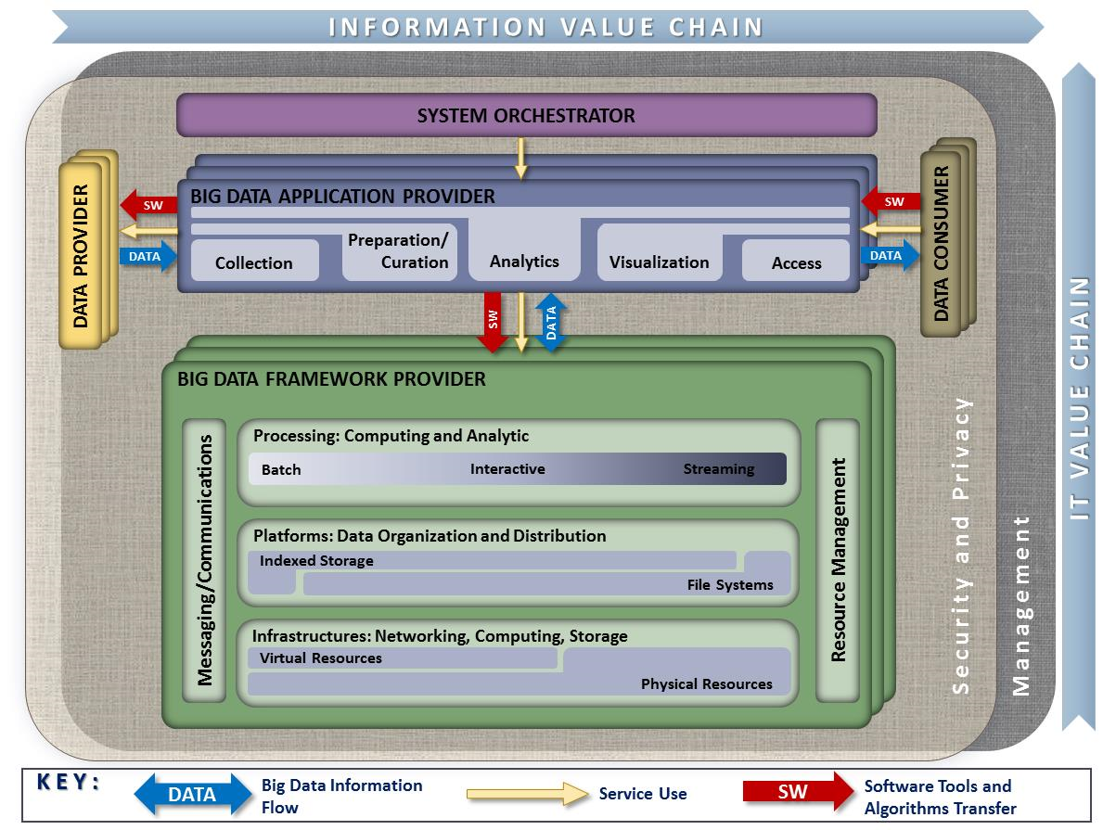
NIST Big Data Reference Architecture (2018)
Main components of the Big Data ecosystem
Data Provider
Big Data Applications Provider
Big Data Framework Provider
Data Consumer
Service Orchestrator
Big Data Lifecycle and Applications Provider activities
Collection
Preparation
Analysis and Analytics
Visualization
Access
Big Data Ecosystem includes all components that are involved into Big Data production, processing, delivery, and consuming
[ref] Volume 6: NIST Big Data Reference Architecture. http://bigdatawg.nist.gov/V1_output_docs.php
Notes:
Important to mention that NIST BD-WG recognizes the environment in which the Big Data are collected, processed and consumed as Ecosystem.
Data Provider is the role of introducing new data or information feeds into the big data system for discovery, access, and transformation by the big data system.
Big Data Application Provider is the role of executing a specific set of data life cycle to meet the requirements established by the System Orchestrator, as well as the Security and Privacy requirements.
Big Data Application Provider includes activities related to the Big Data Lifecycle
Collection
Preparation
Analysis and Analytics
Visualization
Access
As the data propagates through the ecosystem, it is being processed and transformed in different ways in order to extract the value from the information. Each activity within the Big Data Application Provider can be implemented by independent stakeholders and deployed as stand-alone services. As such, the "Application Provider" can be a single or a collection of more granulate "Application Providers", each implementing different steps in the "data lifecycle".
Data Provider activities include:
Collecting the data
Creating the metadata describing the data source(s), usage policies/access rights, and other relevant attributes
Publishing the availability of the information and the means to access it

Slide 15
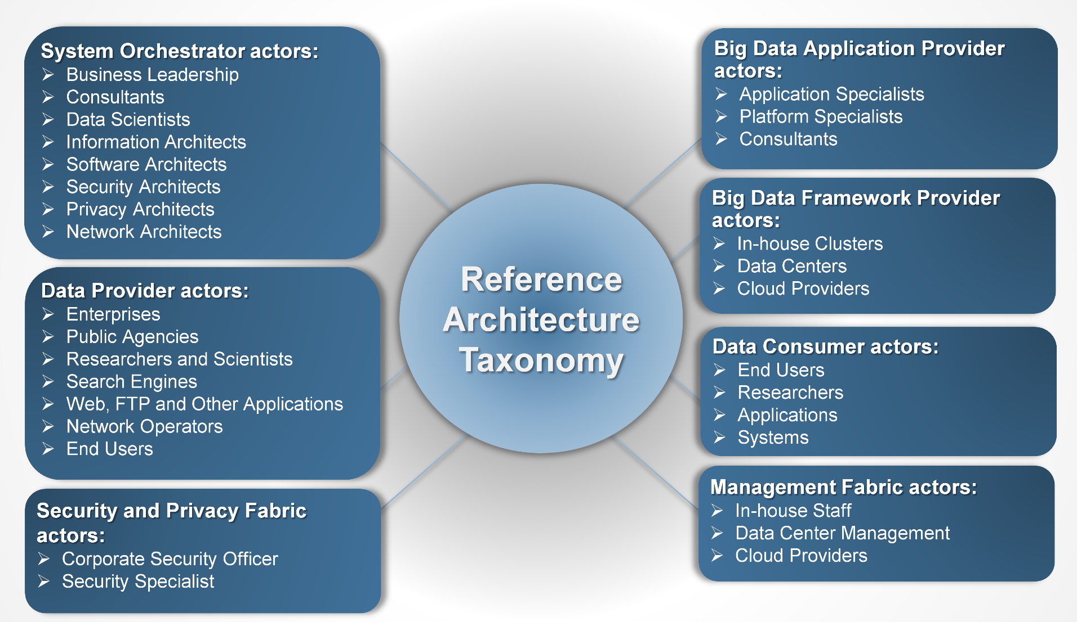
NIST Reference Architecture Taxonomy (2018)
[ref] Volume 6: NIST Big Data Reference Architecture. http://bigdatawg.nist.gov/V1_output_docs.php
Notes:
Important to mention that NIST BD-WG recognizes the environment in which the Big Data are collected, processed and consumed as Ecosystem.
Data Provider is the role of introducing new data or information feeds into the big data system for discovery, access, and transformation by the big data system.
Big Data Application Provider is the role of executing a specific set of data life cycle to meet the requirements established by the System Orchestrator, as well as the Security and Privacy requirements.
Big Data Application Provider includes activities related to the Big Data Lifecycle
Collection
Preparation
Analysis and Analytics
Visualization
Access
As the data propagates through the ecosystem, it is being processed and transformed in different ways in order to extract the value from the information. Each activity within the Big Data Application Provider can be implemented by independent stakeholders and deployed as stand-alone services. As such, the "Application Provider" can be a single or a collection of more granulate "Application Providers", each implementing different steps in the "data lifecycle".
Data Provider activities include:
Collecting the data
Creating the metadata describing the data source(s), usage policies/access rights, and other relevant attributes
Publishing the availability of the information and the means to access it

Slide 16
Data Lifecycle/Transformation Model
Multiple Data Models and structures
Data Variety and Variability
Semantic Interoperability
Data Model (1)
Data Model (2)
Data Model (3)
Data (inter)linking
PID/OID
Identification
Privacy, Opacity
Data Model (4)
Data Storage (Big Data capable)
Data
Collection& Registration
Data
Analytics, Modeling,
Prediction
Consumer applications
Data
Filter/Enrich,
Classification
Data
Delivery,
Visualisation
Data
Source
Data repurposing,
Analytics re-factoring,
Secondary processing
Data Model changes along data lifecycle or evolution
Data provenance is a discipline to track all data transformations along lifecycle
Identifying and linking data
Persistent data/object identifiers (PID/OID)
Traceability vs Opacity
Referral integrity
Notes:
Data Lifecycle/Transformation Model is an important component of the BDAF that affect many aspects of the Big Data infrastructure.
-
It imposes a number of requirements for data management infrastructure that should provide functions for
Data must stored during all transformation stages providing linking and traceability to initial data sets
Data provenance that should allow tracking and recording/documenting all data transformation during lifecycle, ensuring referral integrity of data
Data curation that includes activities to ensure long-term data preservation and availability, may also include data indexing, classification and metadata creation
It is perceived that Data Model may change during data transformation. Data storage solutions should allow data model/structure variability.
NoSQL databases actually have been created to address this kind of problem. Specifically, key/value and columnar NoSQL databases and their numerous implementations allow changing data models and schema.
Important feature of Big Data Life is possibility of Data repurposing and secondary processing applying improved analytics methods. Having also a possibility to run historical data analysis.

Slide 17
SQL and NoSQL
NoSQL definition (www.nosql-database.org):
Next Generation Databases mostly addressing some of the points: being non-relational, distributed, open-source and horizontal scalable.
Other characteristics apply: schema-free, easy replication support, simple API, eventually consistent / BASE (not ACID), a huge data amount, others
ACID/SQL vs BASE/NoSQL
ACID Semantics: Atomic, Consistent, Isolated, Durable
BASE Semantics: Basically Available - Soft State - Eventual Consistency

Slide 18
NoSQL Distinguishing Characteristics
Large data volumes
Web scale “Big Data”
Scalable replication and distribution
Potentially thousands of machines
Potentially distributed around the world
Queries need to return answers quickly
Not necessary precisely
Employing probabilistic search/decision
Mostly query, few updates
Asynchronous Inserts and Updates
Schema – free (on write, schema applied by applications)
Paradigm shift from ACID transaction properties to BASE
CAP Theorem – NoSQL database types
Open source development

Slide 19
Brewer’s CAP Theorem
Brewer’s (CAP) Theorem (original formulation) [ref]
“There are three core systemic requirements that exist in a special relationship when it comes to designing and deploying applications in a distributed environment.”
A distributed system can support only two of the following characteristics:
Consistency
All nodes see the same data at the same time
Availability
Node failures do not prevent survivors from continuing to operate
Partition tolerance
The system continues to operate despite arbitrary message loss
[ref] http://www.julianbrowne.com/article/viewer/brewers-cap-theorem
Consistency
CA
Availability
Not Possible
CP
AP
Partition Tolerance
The CAP Theorem Dilemma in Cloud Database and Storage

Slide 20
Main NoSQL Database Types and Existing Implementations
Column Store: Each storage block contains data from only one column
BigTable by Google, Apache HBase, Cassandra
Work natively with HDFS and Hadoop
Document Store: Store documents (in particular XML) made up of tagged elements
MongoDB, CouchDB, RaptorDB, CosmosDB
Key-Value Store: Hash table of keys with arbitrary data as content/value
Memcached, Membase, Accumulo, Amazon DynamoDB
Graph Databases: Store data in graph data in Triplestores or Quadstores
Neo4J, FlockDB, GraphDB
Notes:
Should we refer students to a specific tutorial?

Slide 21
Visualizing the CAP Theorem and it’s members
Data Models:
(R) Relational (Comparison)
(K) Key Value
(C) Column-Oriented/Tabular
(D) Document-Oriented
(G) Graph
Configurable consistency:
Azure CosmosDB (K,C,D,G), AWS Aurora (R), Google Spanner (R)
Availability
Each client can always read and write
CA
(R) RDBMs such | (R) Aster Data
as MySQL, Oracle, | (R) Greenplum
DB2, PostgreSQL, | (D) CouchDB
SQL Server, etc. | (C) Vertica
A
AP
(K) Dynamo | (C) Cassandra
(K) Voldemort | (D) SimpleDB
(K) Tokyo Cabinet | (D) CouchDB
(K) KAI | (D) Riak
Pick Two
C
P
Consistency
All clients always have the same view of data
Partition Tolerance
The system works well despite physical network partitions
 | CP
(C) BigTable | (D) MongoDB | (K) BerkeleyDB | (R) VoltDB
(C) Hypertable | (D) Terastore | (K) MemcacheDB
(C) Hbase | (K) Scalaris | (K) Redis
Notes:
The diagram on this slide illustrates the CAP Theorem visibly. It also categorizes commercial and open source implementations into one of the three CAP Theorem categories.

Slide 22
Modern Cloud Databases and CAP Theorem Challenges
Google Spanner SQL database
AWS Aurora Big SQL database
Azure CosmosDB (NoSQL multi-data format database with underlying blob storage and HDFS)

Slide 23
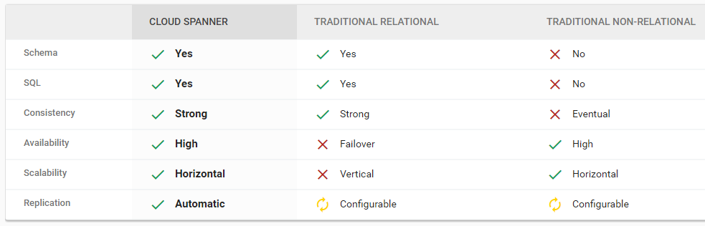
Cloud Spanner - Mission Critical RDBMS
SQL Database
Best of both worlds
Strong consistency and high availability worldwide

Slide 24
Amazon Aurora – Big SQL database
High performance and scalability
High availability and durability
High security
MySQL and PostgreSQL Compatible
Fully managed
Migration support

Slide 25
Azure CosmosDB (former DocumentDB) – Multi-model global distributed database

Slide 26
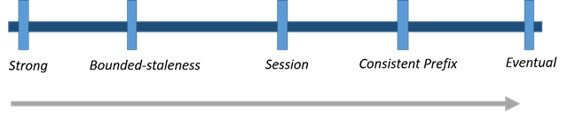
CosmosDB: Consistency and latency
Five Consistency Models
Helps navigate Brewer's CAP theorem
Intuitive Programming
Tunable well-defined consistency levels
Override on per-request basis
Clear PACELC tradeoffs
Partition – Availability vs Consistency
Else – Latency vs Consistency
Guaranteed low latency at P50 and P99 percentile
Globally distributed with requests served from local region
Write optimized, latch-free database
Automatic Indexing

Slide 27
CosmosDB: Consistency levels and guarantees
Consistency Level | Guarantees
Strong | Linearizability
Bounded Staleness | Consistent Prefix. Reads lag behind writes by k prefixes or t interval
Session | Consistent Prefix. Monotonic reads, monotonic writes, read-your-writes, write-follows-reads
Consistent Prefix | Updates returned are some prefix of all the updates, with no gaps
Eventual | Out of order reads
Lower latency, higher availability, better read scalability

Slide 28
MapReduce and Hadoop ecosystem
MapReduce Computation Model
Hadoop and components
HDFS – Hadoop Distributed File System

Slide 29
MapReduce Programming Model
Map/Reduce is a programming model based on LISP that allows simple distribution of computing tasks across nodes. It includes two stages:
Map: Perform a function on individual values in datasets to create a new list of values
Reduce: Combine values from the new list to create a new value
Input and output are presented as key/value pairs. The following code fragment expresses the two operations map() and reduce() that run in parallel for two strings to execute word count:
map (in_key, in_value)
list (out_key, intermediate_value)
reduce (out_key, list (intermediate_value))
list (out_value)
Notes:
MapReduce is one of key programming model for parallel data processing capable of scaling to deal with the Big Data volumes.
Knowing is beneficial for correct evaluation and selection of the Big Data solutions and products.

Slide 30
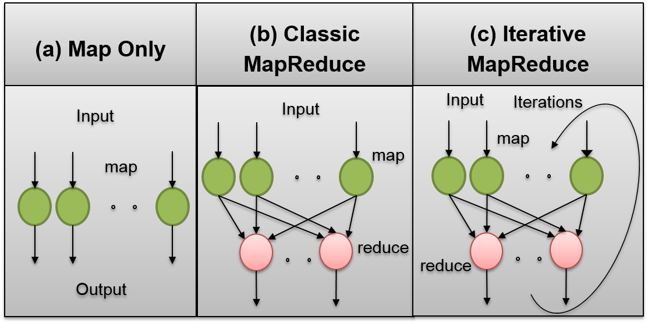
Three Forms of MapReduce
The Map function produces an intermediate value for the intended output key, the Reduce function combines all intermediate values for a particular key.
Data flow in different forms of MapReduce: (a) Map Only; (b) Classic MapReduce; (c) Iterative MapReduce.
The classic MapReduce operates in a synchronous mode.
Input data are partitioned and multiple map() tasks are run in parallel.
After all map()s are complete, all intermediate values are combined for all unique keys by running multiple reduce() tasks in parallel.

Slide 31
Word Count Operations Allocation to Map/Reduce
Input strings |  | Mapper |  |  | Reducer
 |  | Green | 1 |  | Fruit | 2
 |  | Fruit | 1 |  | Green | 1
Green fruit hangs | ➔ | Hangs | 1 | ➔ | Hangs | 1
Tropical fruit orange | ➔ |  |  | ➔ | Tropical | 1
 |  | Tropical | 1 |  | Orange | 1
 |  | Fruit | 1
 |  | Orange | 1
Input
HDFS
Mapper
Sort/Copy
Output
Green 1
Green Fruit Hangs
Fruit 1
Merge
Hangs 1
Green 1
Green [1]
Fruit [1 1]
Tropical [1]
Reducer
Fruit 2
Green 1
Tropical 1
Fruit 1
Fruit 1
Tropical Fruit Orange
Mapper
Tropical 1
Tropical 1
Fruit 1
Orange 1
Orange 1
Hangs 1
Fresh Orange
Orange 1
Hangs [1]
Orange [1 1 1]
Fresh [1]
Reducer
Orange 3
Hangs 1
Fresh 1
Orange 1
Mapper
Orange 1
Orange
Fresh 1
Fresh 1
Orange 1
Notes:
The following code fragment expresses the two operations map() and reduce() that run in parallel for two strings to execute word count:
map (key=line, value=content)
map_output (word, “1”)
reduce (key=word, value=individual_counts)
output (word, sum_occurances)

Slide 32
Hadoop Cluster operation on MapReduce
For Map machine
Read content and prepares data from assigned portion of input data
Feed data into Map function and saves result to local disk
Notifies Master about (partially) completed work
For Reduce machine
Receive notification from Master about (partially) completed Map work
Retrieve intermediate data from Map machine via remote read
Sorts intermediate data by key (e.g. by key word)
Iterate over intermediate data for each unique key and sends corresponding set through Reduce function
Add result to final output file or dataset and write it to HDFS storage.

Slide 33
MapReduce and Hadoop
Java based
Designed for scalability
Up to TB data: distributed, not-consistent
And not for speed
Even simple data query task will take seconds

Slide 34
Apache Hadoop (Release 2.2+)
Pig
Hive
Tez
Other Hadoop-related projects at Apache include:
Hive: A data warehouse system that provides data aggregation and querying.
Pig: A high-level data-flow language and execution framework for parallel computation.
HBase: A distributed column oriented database that supports structured data storage for large tables
Cassandra: A scalable multi-master database protected against hardware failure
Tez: A generalized data-flow programming framework, built on Hadoop YARN, which provides a powerful and flexible engine to execute an arbitrary DAG of tasks to process data for both batch and interactive use-cases.ooKeeper: A scalable coordination service for distributed applications.
Spark: A fast and general compute engine for Hadoop data. Spark provides a simple and expressive programming model that supports a wide range of applications, including ETL, machine learning, stream processing, and graph computation.
Mahout: A scalable machine learning and data mining library.
Avro: A data serialization system that supports rich data structures
Chukwa: A data collection system for managing large distributed systems.
Ambari: A web-based tool for provisioning, managing, and monitoring Apache Hadoop clusters
Chukwa, Others
HBase
MapReduce
Zookeeper
Ambari
YARN
HDFS
Apache Hadoop software stack includes the following main modules:
Hadoop Common: The common utilities that support the other Hadoop modules and includes utilities and drivers to support different computer cluster and language platforms.
HDFS: Hadoop Distributed File System optimized for large scale storage and processing of data on commodity hardware
Hadoop YARN: A framework for job scheduling and cluster resource management.
Hadoop MapReduce: A YARN-based system for parallel processing of large data sets.
Notes:
Apache Hadoop is a core component of a modern data architecture that is currently integrated with existing enterprise data management and in particular Enterprise Data Warehouse
Apache Avro provides important functionality for consistent data management that includes rich data structures
JSON based container file for storing persistent data, and
Remote Procedure Call (RPC) for low overhead data communication.
JSON based schema for data structure description is stored together with data and easily integrated with the programming platform.

Slide 35
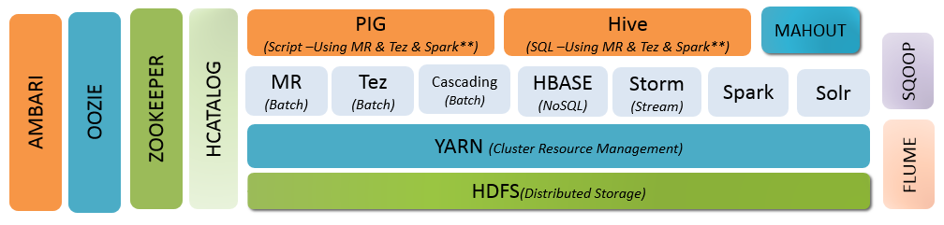
Hadoop Ecosystem – Layered view

Slide 36
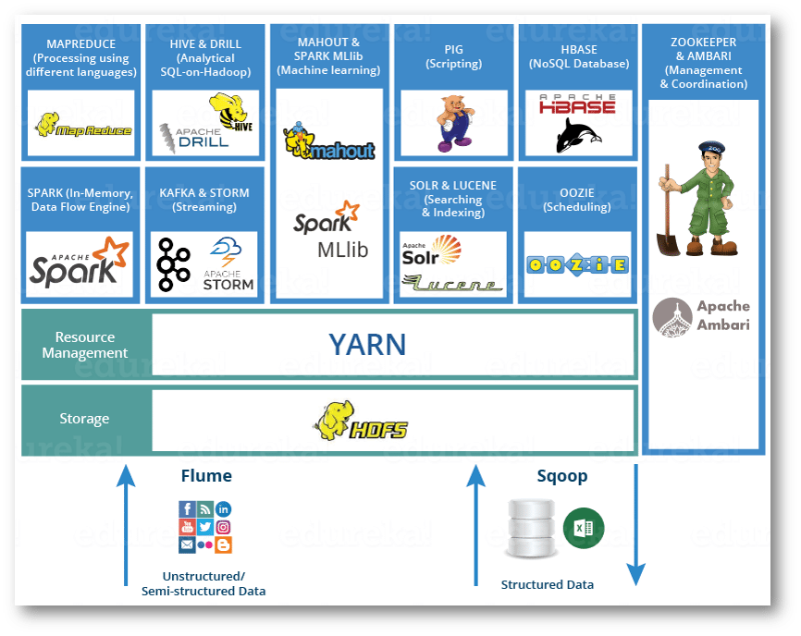
Zoo style Hadoop Ecosystem

Slide 37
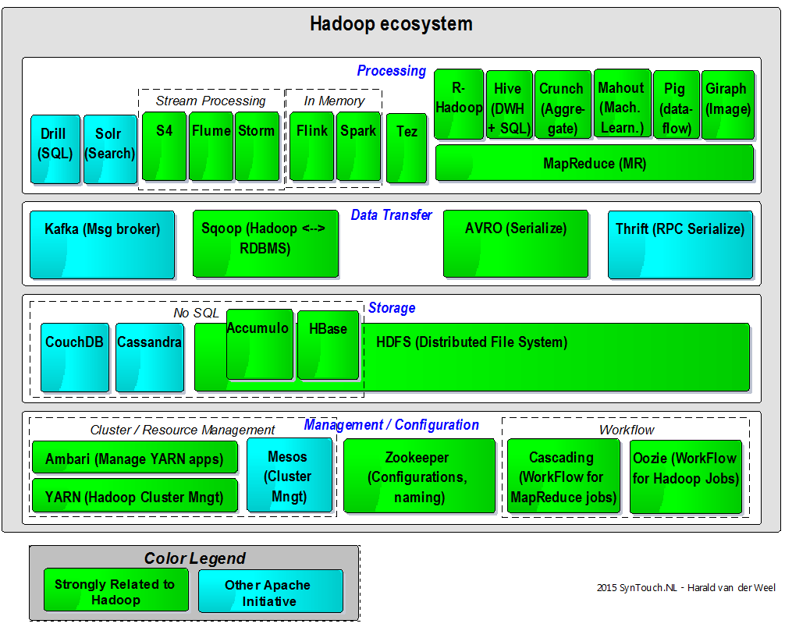
Hadoop Ecosystem – Layered by functional groups

Slide 38
Hadoop Cluster Architecture – “Physical” view
master node
namenode
job submission node
namenode daemon
jobtracker
Map
Reduce
Map
tasktracker
tasktracker
tasktracker
Split 0
datanode daemon
datanode daemon
datanode daemon
Linux file system
Linux file system
Linux file system
…
…
…
slave node
slave node
slave node
Split 1
Notes:
Hadoop cluster defines three kinds of machine roles: Master node, Slave (or Worker) node, and Client machine (not shown)

Slide 39
Hadoop Cluster Architecture - Operation
The Master node includes
Name Node that coordinates the data storage and files namespace in HDFS
Job Tracker that coordinates the MapReduce execution on the Worker nodes.
The Master node manages the two main processes: storing data in HDFS and running parallel computation what include activities:
Initialise the cluster and split data and tasks according to number of available Workers
Send each Worker its part of data
Receive the results from each Worker
Re-execute task in case a Worker failed
Master coordinates data exchange between Map and Reduce machines
The Slave (or Worker) node stores data and runs assigned map() or reduce() tasks.
Each Slave node runs both a Data Node that stores own part of data in HDFS and a Task Tracker daemon that communicates with and receives instructions from the Master node.
Data partitioning and placement on Worker nodes is done to minimize data communication between general HDFS data storage and worker machines
Takes into account that Hadoop cluster can occupy few racks and data files can be split between nodes and racks
The Client machine doesn’t run any of MapReduce tasks but it communicates with the Master, loads data into cluster, submits MapReduce jobs, and retrieves results.
Notes:
The Master node includes the Name Node that coordinates the data storage and files namespace in HDFS, and the Job Tracker that coordinates the MapReduce execution on the Worker nodes.
Master node manages the two main processes: storing data in HDFS and running parallel computation that include activities:
Initialise the cluster and split data and tasks according to number of available Workers
Send each Worker its part of data
Receive the results from each Worker
Re-execute task in case a Worker failed
The initialization process includes such actions as
Split input data into 64 MB sections (as used by GFS and HDFS) and assign to different Worker machines
Fork off (i.e., split) program onto multiple machines
Master assigns available machines to perform ether Map or Reduce tasks
Master coordinates data exchange between Map and Reduce machines.
The Slave (or Worker) node stores data and runs assigned map() or reduce() tasks. Each Slave node runs both a Data Node that stores own part of data in HDFS and a Task Tracker daemon that communicates with and receives instructions from the Master node.
The Client machine doesn’t run any of MapReduce tasks but it communicates with the Master, loads data into cluster, submits MapReduce jobs, and retrieves results.
When preparing the job execution, Hadoop uses partitioning approach to minimize data communication between general HDFS data storage and worker machines, taking into account that Hadoop cluster can occupy few racks and data files can be split between nodes and racks. For Map tasks it can be just contiguous input data partitioning, for Reduce tasks the optimization is done to ensure that intermediate results with the same intermediate key are assigned to the same worker. Additional optimization can be done by grouping links related to same host or domain.
Hadoop parallel computing model provides a good solution to one of the Big Data dilemma moving computing to data or moving data to computing.
Essential to mention that Hadoop doesn’t use virtualisation in production operation. MapReduce is a synchronous parallel computing model and is critical to delays and overhead.

Slide 40
HDFS Architecture
File content is split into blocks (default 128MB, 3 replica).
NameNode maintains the namespace tree and the mapping of file blocks to DataNodes.
Files and directories are represented on the NameNode by inodes (permissions, modification and access times, namespace and disk space quotas).
Namespace is a hierarchy of files and directories.
[ref] HDFS Architecture Guide. Apache Foundation. - http://hadoop.apache.org/docs/r1.2.1/hdfs_design.html
Notes:
HDFS is a basis of the Hadoop cluster
HDFS cluster consists of a single master node/server that runs NameNode and multiple DataNodes, usually one per physical node in the Hadoop cluster. User data are stored in the files, externally they are exposed through namespace managed by the NameNode. To access a file, a user client needs to request a file location or metadata from the NameNode, and after that it can send read or write request to the DataNode directly. DataNodes create data blocks and do replication based on instructions from NameNode.
HDFS support a simple hierarchical file system that allows creating directories, subdirectories and hierarchies. NameNode maintains the file system namespace and records all changes to the namespace or file properties, including the number of replicas maintained by HDFS.
To achieve high reliability, availability and fault tolerance, HDFS maintains a few replicas of the data stored data. The replication approach is node and rack aware. For example, if the replication factor is 3, then HDFS puts two replicas on different nodes in the same rack, and one replica in a different rack. When selecting replicas for computation, the system selects closest replica from the same rack to minimize data transition time.

Slide 41
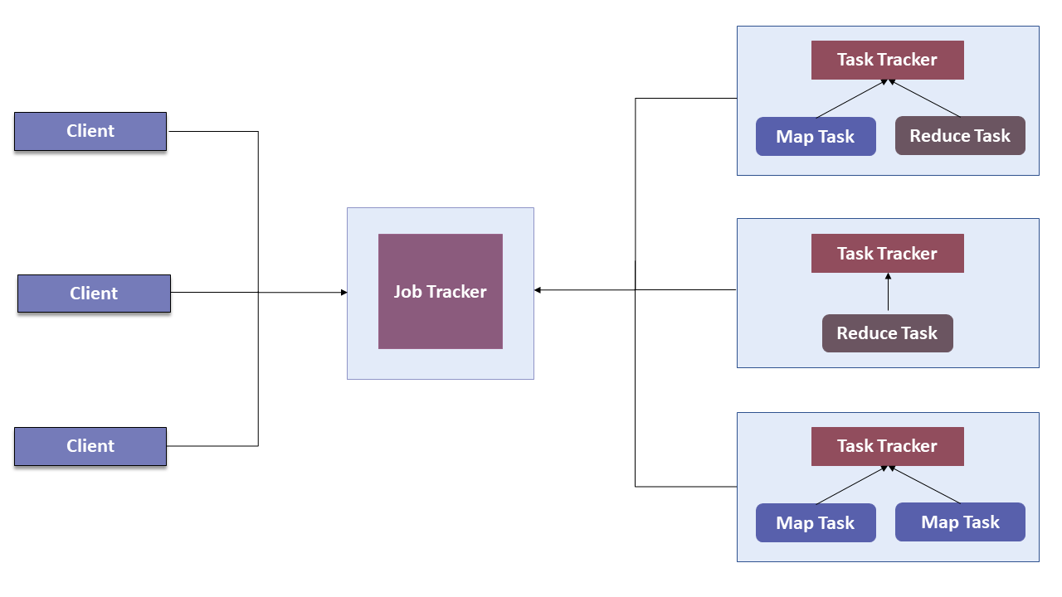
YARN vs MapReduce – MapReduce Hadoop v1.0
Scalability issue MapReduce Hadoop v1.0
According tom Yahoo! – max 5000 nodes and 40,000 tasks running concurrently
Utilization of computational resources is inefficient in MRV1

Slide 42
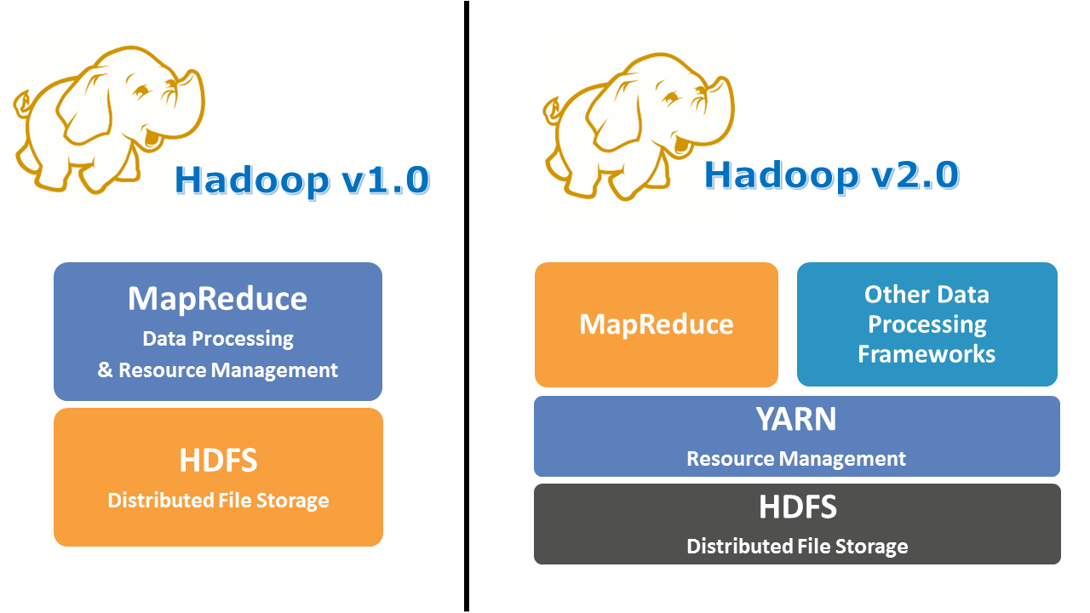
YARN since Hadoop v2.0
YARN – Yet Another Resource Negotiator since Hadoop v2.0
YARN performs all processing activities by allocating resources and scheduling jobs/tasks

Slide 43
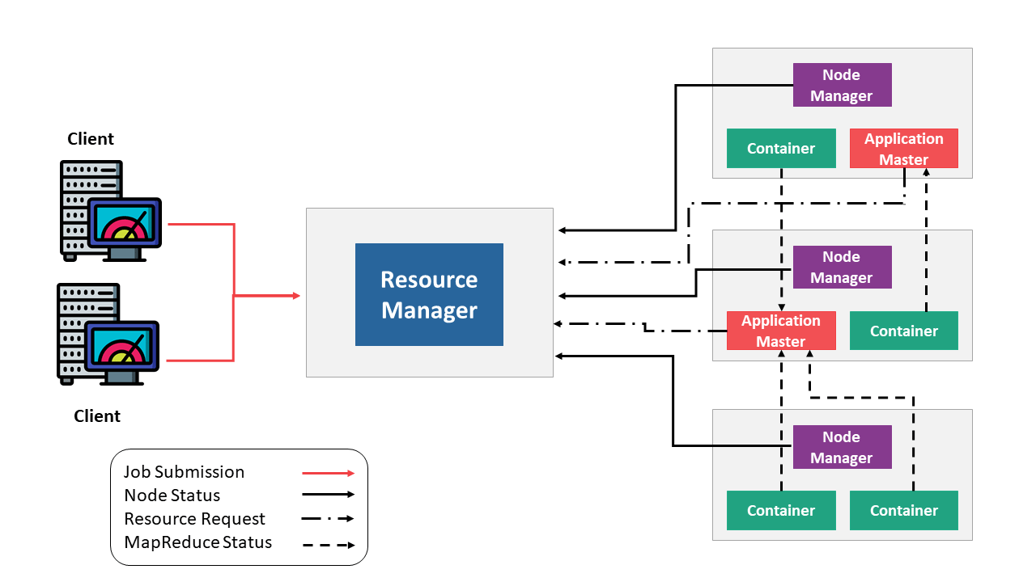
YARN components
Resource Manager: Runs on a master daemon and manages the resource allocation in the cluster.
Node Manager: They run on the slave daemons and are responsible for the execution of a task on every single Data Node.
Application Master: Manages the user job lifecycle and resource needs of individual applications. It works along with the Node Manager and monitors the execution of tasks.
Container: Package of resources including RAM, CPU, Network, HDD etc on a single node.

Slide 44
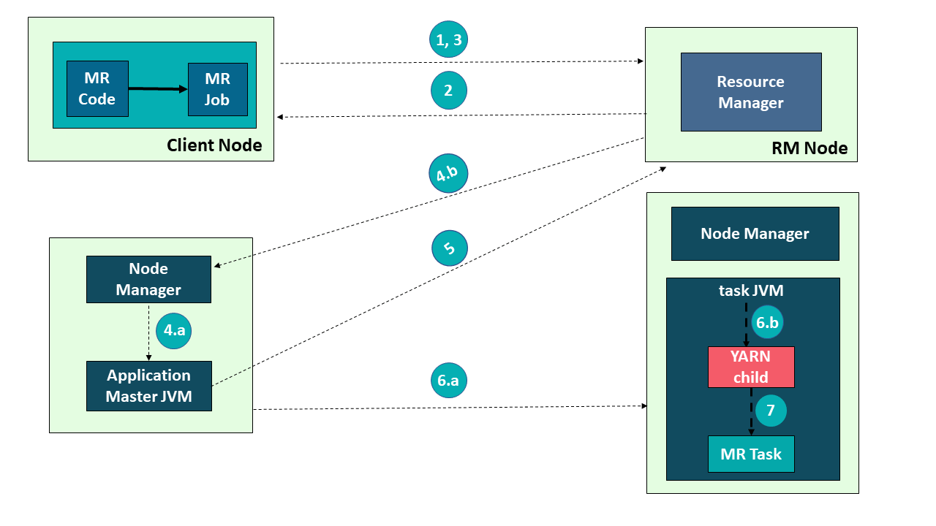
Jobs Submission in YARN
Submit the job
Get Application ID
Get Application Submission Context
4 a) Start Container Launch
4 b) Launch Application Master
5) Allocate Resources
6 a) Container
6 b) Launch
7) Execute

Slide 45
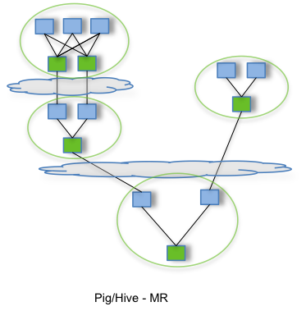
Apache Tez
Tez is application framework which allows for a complex directed-acyclic-graph of tasks for processing data
Allows Hive and Pig tasks to run a complex DAG of tasks
Tez can be used to process data, that earlier took multiple MR jobs, now in a single Tez job
Reconfiguration at run time

Slide 46
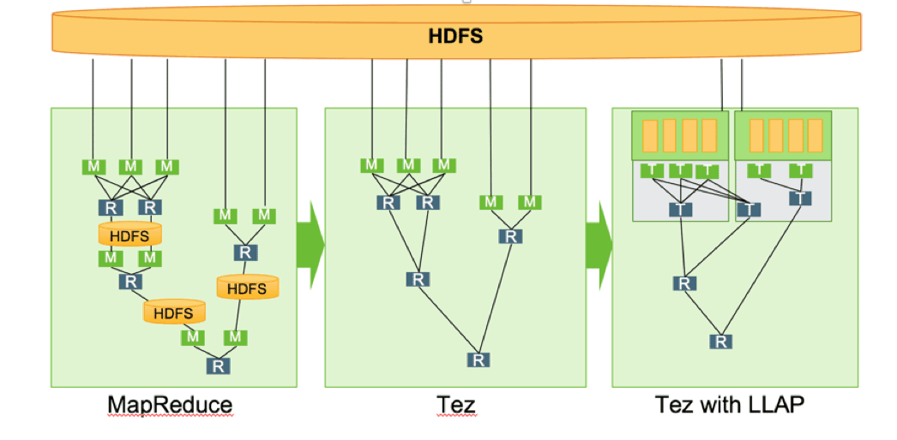
Apache Tez – Further improvement with LLAP by Hortonworks
25x times faster
performance
with LLAP
LLAP (Live Long and Process) combines persistent query servers and optimized in-memory caching that allows Hive to launch queries instantly and avoids unnecessary disk I/O.
LLAP caches memory intelligently and it shares this data among all clients, while retaining the ability to scale elastically within a cluster. LLAP brings compute to memory (rather than compute to disk),
Worker tasks run inside LLAP daemons, and not in containers

Slide 47


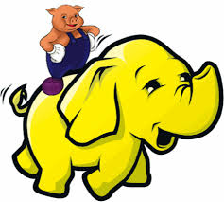

Hive, Pig Latin, Oozie
Solution: Provide higher-level data processing languages
Hive: Data warehousing application in Hadoop
Query language is HQL, variant of SQL
Tables stored on HDFS as flat files
Developed by Facebook, now open source
Pig: Large-scale data processing system
Scripts are written in Pig Latin, a dataflow language
Developed by Yahoo!, now open source, Roughly 1/3 of all Yahoo! internal jobs
Oozie
Server-based workflow scheduling system to manage Hadoop jobs.
Workflows defined as a collection of control flow and action nodes in a directed acyclic graph.
Common idea:
Provide higher-level language to facilitate large-data processing
Higher-level language “compiles down” to Hadoop jobs

Slide 48
Summary and take away
Big Data technologies target to support storing, processing and managing large and growing amount of data of large Volume, high Velocity and wide Variety
Big Data Infrastructure needs to support the whole Big Data lifecycle including data collection, filtering, processing, visualization, and storing
MapReduce is a programming model for parallel data processing that is commonly used for Big Data processing and analytics
Hadoop is a designated cluster solution for MapReduce
Hadoop is a batch processing system that implement paradigm of moving processing to data
Apache Hadoop is an Open Source software stack that includes a number of products to support the whole Big Data processing ecosystem
Notes:
In this Lesson we covered

Slide 49
Cloud based Storage for Big Data
Hadoop Distributed File System (HDFS)
Data Lakes
Large Scale Databases with controlled consistency

Slide 50
Revisiting: Hadoop – Core components
Hadoop is a highly reliable, distributed, and parallel programming framework for analyzing big data
A Java-based, open source Apache project
Capable of running on a variety of hardware platforms, including clusters of commodity hardware
The Hadoop core includes:
A scalable, reliable file system (HDFS)
A framework that enables development of programs based on MapReduce (MR) or directed acyclic graph (DAG) model
YARN, a distributed resource manager that allocates and controls access to resource of cluster manager
In addition to the core, Hadoop has a rich ecosystem that supports SQL/NoSQL, streaming, real-time, and interactive applications
Hadoop core
MapReduce
Tez
(data processing framework)
YARN (cluster resource manager)
HDFS
(redundant, reliable storage)

Slide 51
Hadoop Distributed File System (HDFS)
A scalable distributed file system for large scale data analysis
A part of the Open Source Apache Hadoop suite
The primary storage used by Hadoop MapReduce applications
Can run on commodity hardware assuring high fault-tolerant
HDFS is platform layer for Data Lakes
Hadoop core
MapReduce
Tez
(data processing framework)
YARN (cluster resource manager)
HDFS
(redundant, reliable storage)
A Cluster of Machines
and Cloud Storage
Notes:
The Hadoop Distributed File System (HDFS) is a very different sort of “filesystem” optimized for a specific class of applications, those are Map Reduce and similar “Big Data” systems like “no-SQL” databases.
It is a scalable distributed file system for large scale data analysis
A part of the Open Source Apache Hadoop suite
The primary storage used by Hadoop MapReduce applications
Can run on commodity hardware assuring high fault-tolerant

Slide 52
Data Lakes - Definition
Data Lake allows an organization to store all of their data, structured and unstructured, in one, centralized repository.
Since data can be stored as-is, there is no need to convert it to a predefined schema and you no longer need to know what questions you want to ask of your data beforehand.
A Data Lake should support the following capabilities:
Collecting and storing any type of data, at any scale and at low costs
Securing and protecting all of data stored in the central repository
Searching and finding the relevant data in the central repository
Quickly and easily performing new types of data analysis on datasets
Querying the data by defining the data’s structure at the time of use (schema on read)

Slide 53
Data Lake layers
Raw data layer – Raw events are stored for historical reference. Also called staging layer or landing area
Cleansed data layer – Raw events are transformed (cleaned and mastered) into directly consumable data sets. Aim is to uniform the way files are stored in terms of encoding, format, data types and content (i.e. strings). Also called conformed layer
Application data layer – Business logic is applied to the cleansed data to produce data ready to be consumed by applications (i.e. DW application, advanced analysis process, etc). Also called workspace layer or trusted layer
Still need data governance so your data lake does not turn into a data swamp!

Slide 54
AWS Data Lake Storage Architecture
A Data Lake solution on AWS, at its core, leverages Amazon Simple Storage Service (Amazon S3) for secure, cost-effective, durable, and scalable storage.
Data Management with DynamoDB
Data Analysis with AMR

Slide 55







Azure Data Lake
Information management
Big data stores
Machine Learning and Analytics
Dashboards and visualizations
Business apps
Power BI
Azure
Data Factory
Azure
SQL Data Warehouse
Azure
Machine Learning
Personal digital assistant
Cortana
People
Azure
Stream Analytics
Custom apps
Azure
Data Catalog
Perceptual intelligence
Azure
HDInsight (Hadoop)
Face, vision
Azure
Data Lake Store
Speech, text
Azure
Event Hub
Azure
Data Lake Analytics
Business scenarios
Sensors and devices
Recommendations,
customer churn,
forecasting
Automated systems
DATA
INTELLIGENCE
ACTION
Azure Data Lake Analytics is a part of Cortana Analytics Suite
Notes:
Objective: This slide shows that Azure Data Lake is a key part of Cortana Analytics Suite for Big Data Applications with a centralized repository of structured and unstructured data with elastic scale for enterprise-wide analytics.
Talking Points:
Cortana Analytics is a fully managed big data and advanced analytics suite that enables you to transform your data into intelligent action.
Data Lake Analytics is also a key part of Cortana Analytics Suite and works with Azure SQL Data Warehouse, Power BI, and Data Factory.
This gives you a complete cloud big data and advanced analytics platform to help you with everything from preparing data to doing interactive analytics on large-scale datasets.

Slide 56
Cloud based Big Data Platforms and Solutions
Amazon Web Services (AWS)
Google Cloud Platform (GCP)
Microsoft Azure

Slide 57
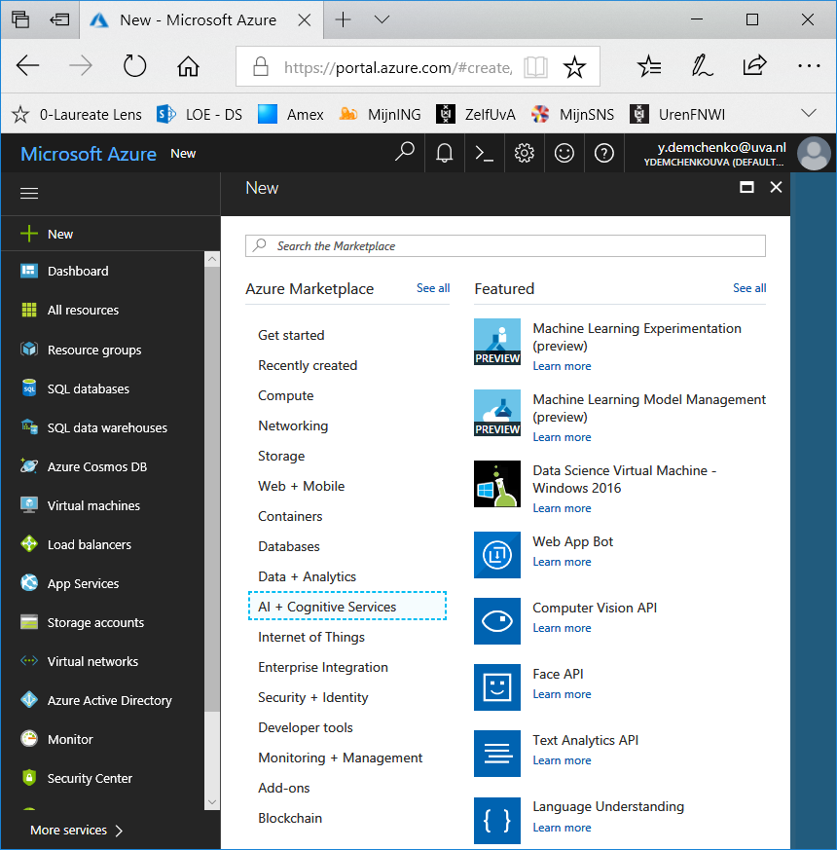
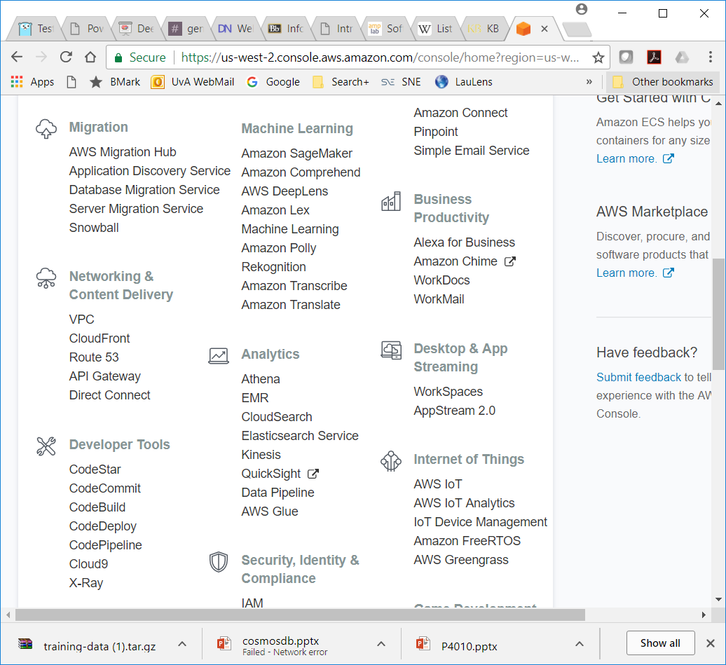
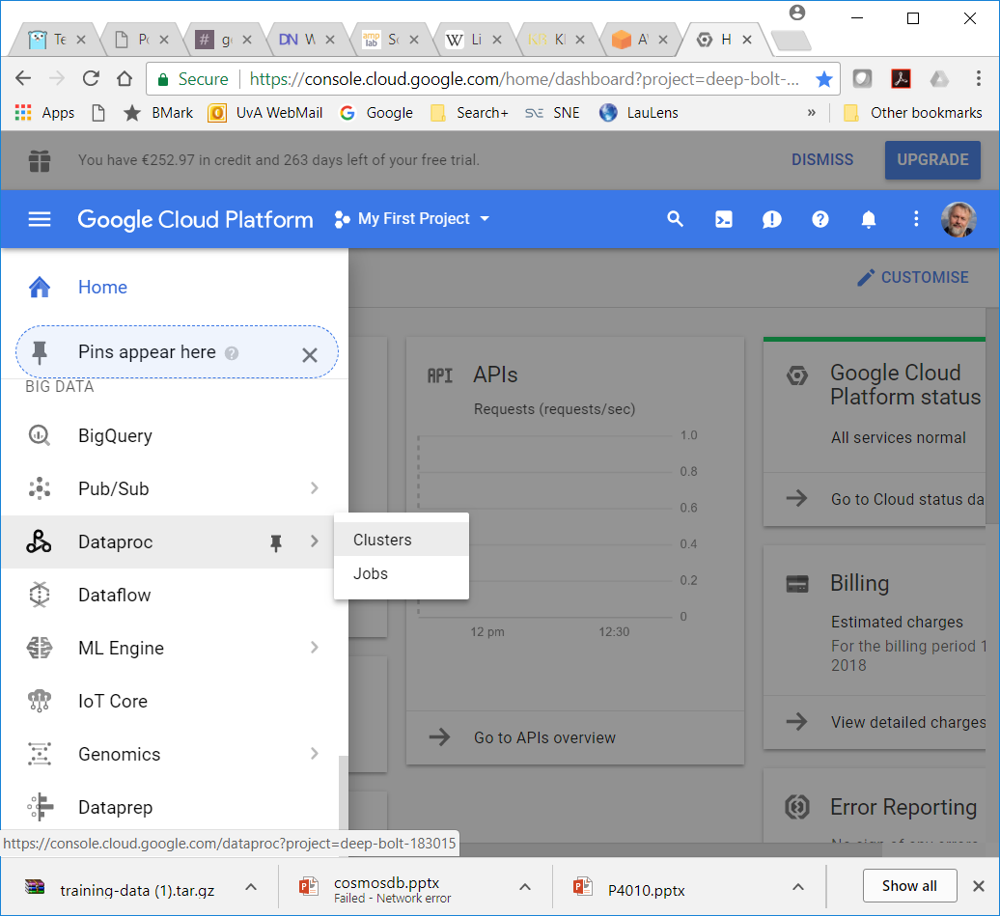
Google, AWS, Azure Big Data Stacks

Slide 58
Amazon EC2 HPC oriented AMI instances
Amazon EC2 offers dedicated computation optimized VMs and “cluster instances” that deliver better performance to HPC users
Two Cluster Compute instances that provide a very large amount of CPU coupled with increased network performance (10GigE). Instances come in two sizes,
Nehalem-based “Quadruple Extra Large Instance” (eight cores/node, 23GB of RAM, 1.7TB of local storage)
Sandy Bridge-based “Eight Extra Large Instance” (16 cores/node, 60.5GB of RAM, 3.4TB of local storage).
Besides the Amazon cluster instance, users may select from one of several preconfigured clusters
Additionally, two other specialized instances for HPC clusters
Cluster GPU instance that provides two NVidia Tesla Fermi M2050 GPUs with proportionally high CPU and 10GigE network performance.
High-I/O instance that provides two SSD-based volumes, each with 1024GB of storage.
Pricing can vary depending upon on-demand, scheduled, or spot purchase of resources
Quadruple Extra Large Instance is US$ 1.3/hour (US$ 0.33/core·hour)
Eight Extra Large Instance is US$ 2.4/hour (US$ 0.15/core·hour)
Cluster GPU instance is US$ 2.1/hour, and the High I/O instance is US$ 3.1/hour
For example
Small usage case (80 cores, 4GB of RAM per core, and basic storage of 500GB) would cost US$ 24.00/hour (10 Eight Extra Large Instances)
Larger usage case (256 cores, 4GB of RAM per core, and 1TB of fast global storage) would cost US$ 38.4/hour (16 Eight Extra Large Instances)
Once created, the instances must be provisioned and configured to work as a cluster by the user
Total cost depends on compute time, total data storage and data transfer cost
Amazon does not charge for data transferred into EC2 but has a varying rate schedule for transfer out of the cloud; additionally, there are EC2 storage costs

Slide 59
AWS Cloud Big Data Services
AWS Cloud offers the following services and resources for Big Data processing:
EC2 Virtual Machine (VM) instances for HPC optimized for computing (with multiple cores) and with extended storage for large data processing.
Amazon Elastic MapReduce (EMR) provides the Hadoop framework on Amazon EC2 and offers a wide range of Hadoop related tools.
Amazon Kinesis is a managed service for real-time processing of streaming big data (throughput scaling from megabytes to gigabytes of data per second and from hundreds of thousands different sources).
Amazon DynamoDB highly scalable NoSQL data stores with sub-millisecond response latency.
Amazon Aurora scalable relational database.
Amazon Redshift fully-managed petabyte-scale data warehouse in cloud at cost less than $1000 per terabyte per year.
Amazon Machine Learning
Machine Learning (Artificial Intelligence) based services (Lex, Translate, Recognition, etc.)

Slide 60
Google Cloud Platform (GCP)
Compute
AppEngine
Google Functions (serverless with Node.js)
Storage: Static, sharing, backup, for applications and computation
Cloud Spanner SQL database
Big Data
BigQuery – Hadoop Data Warehouse
Machine Learning services
Translate
Prediction
Cloud endpoints

Slide 61
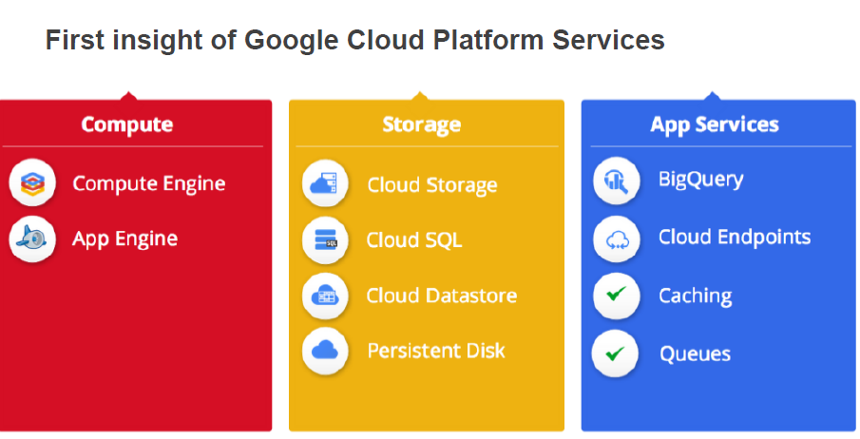
Google Cloud Platform (GCP) structure

Slide 62

Google App Engine (GAE) is a Platform as a Service (PaaS) cloud computing platform for developing and hosting web applications in Google-managed data centers.
Java
Python
PHP
GO
Google’s Go:
Go is an Google’s open source programming environment.
Tightly coupled with Google App Engine.
Applications can be written using App Engine’s Go SDK.
The sandbox:
All hosted applications run in a secure environment that provides limited access to
the underlying operating system.
Sandbox isolates the application in its own secure, reliable environment.
Limitations imposed by sandbox (for security):
An application can only access other computers over internet using the provided URL fetch and email services.
Free ???
Yes, free for up to 1 GB of storage and enough CPU and bandwidth to support 5 million page views a month. 10 Applications per Google account.

Slide 63
Machine Learning Focus
Machine Learning embedded across most products
Multiple Tensorflow ML models in use
Portable TensorFlow models
Key models exposed via APIs (Democratizing Machine Learning)
Cloud Video Intelligence API
Cloud Vision API
Cloud Natural Language API
Cloud Translation API
Cloud Speech API
Acquired Kaggle in 2017 - Data Science Enthusiasts

Slide 64
Google Machine Learning
Support all stages of ML workflow
Dataprep: Serverless platform for all stages of the analytics data lifecycle

Slide 65
Microsoft Azure Big Data Services
New Big Data data-centric thinking
Azure Data Lakes
HDInsight

Slide 66
Traditional business analytics process
Start with end-user requirements to identify desired reports and analysis
Define corresponding database schema and queries
Identify the required data sources
Create a Extract-Transform-Load (ETL) pipeline to extract required data (curation) and transform it to target schema (‘schema-on-write’)
Create reports, analyze data
New
requirements
Create ETL pipeline
Identify data sources
Create reports Do analytics
Identify data schema and queries
Relational
Dedicated ETL tools (e.g. SSIS)
ETL pipeline
Queries
LOB Applications
Defined schema
Results
All data not immediately required is discarded or archived

Slide 67
New Big Data thinking: All data has value
All data has potential value
Data hoarding
No defined schema—stored in native format
Schema is imposed and transformations are done at query time (schema-on-read).
Apps and users interpret the data as they see fit
Iterate
Gather data from all sources
Store indefinitely
Analyze
See results

Slide 68
Two approaches to information management for analytics: Top-down and bottom-up
Top-down
(deductive)
Bottom-up
(inductive)
How can we make it happen?
Prescriptive analytics
What will happen?
Theory
Theory
Predictive analytics
Why did it happen?
Hypothesis
Hypothesis
OPTIMIZATION
Pattern
What happened?
Diagnostic analytics
Observation
Observation
Confirmation
Descriptive analytics
VALUE
INFORMATION
DIFFICULTY
Notes:
Objective: This slide shows the two approaches to information management for analytics.
Talking Points:
There are two approaches to doing information management for analytics:
Top-down (deductive approach). This is where analytics is done, starting with a clear understanding of corporate strategy where theories and hypothesis are made up front. The right data model is then designed and implemented prior to any data collection. Oftentimes, the top-down approach is good for descriptive and diagnostic analytics. What happened in the past and why did it happen?
Bottom-up (inductive approach). This is the approach where data is collected up front before any theories and hypothesis are made. All data is kept so that patterns and conclusions can be derived from the data itself. This type of analysis allows for more advanced analytics such as doing predictive or prescriptive analytics: what will happen and/or how can we make it happen?
In Gartner’s 2013 study, “Big Data Business Benefits Are Hampered by ‘Culture Clash,’” they make the argument that both approaches are needed for innovation to be successful. Oftentimes what happens in the bottom-up approach becomes part of the top-down approach.

Slide 69

Data Warehousing uses a top-down approach
Understand corporate strategy
Gather requirements
Implement data warehouse
Reporting and analytics design
Reporting and analytics development
BI and analytics
Business
requirements
Dashboards
Reporting
Dimension modeling
Physical design
Data warehouse
ETL design
ETL development
ETL
Technical
requirements
Set up infrastructure
Install and tune
Data sources
OLTP
ERP
CRM
LOB

Slide 70
The Data Lake uses a bottom-up approach
Ingest all data regardless of requirements
Store all data
in native format without schema definition
Do analysis
using analytic engines like Hadoop
Devices
Social
Batch queries
LOB applications
Video
Devices
Interactive queries
LOB applications
Social
Sensors
Real-time analytics
Web
Sensors
Video
Machine Learning
Relational
Web
Clickstream
Data warehouse
Relational
Clickstream
Notes:
Objective: This slide shows how the data lake uses a bottoms-up approach for analytics.
Talking Points:
The data lake, on the other hand, leverages a bottom-up approach.
A data lake is an enterprise-wide repository of every type of data collected in a single place.
Data of all types can be arbitrarily stored in the data lake prior to any formal definition of requirements or schema for the purposes of operational and exploratory analytics.
Advanced analytics can be done using Hadoop, Machine Learning tools, or act as a lower cost data preparation location prior to moving curated data into a data warehouse. In these cases, customers would load data into the data lake prior to defining any transformation logic.
This is bottom-up because data is collected first and the data itself gives you the insight and helps derive conclusions or predictive models.

Slide 71




What is Azure Data Lake (ADL) Store?
A highly scalable, distributed, parallel file system in the cloud specifically designed to work with multiple analytic frameworks
Devices
Video
ADL Analytics
Clickstream
Web
HDInsight
ADL Store
R
Social
Sensors
Spark
Relational
LOB applications
Machine Learning
Unstructured
Semi-structured
Structured
Unlimited account size TB, PB
Individual files size from gigabytes to petabytes
No limits to scale

Slide 72
Azure Data Lake
Information management
Big data stores
Machine Learning and Analytics
Dashboards and visualizations
Business apps
Power BI
Azure
Data Factory
Azure
SQL Data Warehouse
Azure
Machine Learning
Personal digital assistant
Cortana
People
Azure
Stream Analytics
Custom apps
Azure
Data Catalog
Perceptual intelligence
Azure
HDInsight (Hadoop)
Face, vision
Azure
Data Lake Store
Speech, text
Azure
Event Hub
Azure
Data Lake Analytics
Business scenarios
Sensors and devices
Recommendations,
customer churn,
forecasting
Automated systems
DATA
INTELLIGENCE
ACTION
Part of Cortana Analytics Suite
Notes:
Objective: This slide shows that Azure Data Lake is a key part of Cortana Analytics Suite for Big Data Applications with a centralized repository of structured and unstructured data with elastic scale for enterprise-wide analytics.
Talking Points:
Cortana Analytics is a fully managed big data and advanced analytics suite that enables you to transform your data into intelligent action.
Data Lake Analytics is also a key part of Cortana Analytics Suite and works with Azure SQL Data Warehouse, Power BI, and Data Factory.
This gives you a complete cloud big data and advanced analytics platform to help you with everything from preparing data to doing interactive analytics on large-scale datasets.

Slide 73

Hybrid Data Lake Model in Azure
On-premises
Azure Cloud
Hadoop cluster
Azure HDInsight
MAP Reduce
Hive, Pig
HBase
Storm
MAP Reduce
Hive, Pig
HBase
Storm
YARN-based Compute
YARN-based Compute
HDFS/WebHDFS API
Hadoop Distributed File System
Azure Data Lake
WebHDFS API
Hadoop Distributed File System
Notes:
Objective: This slide discusses the concepts of data lakes in the three areas: On-Premises Hadoop Cluster, Azure HDInsight, and Azure Data Lake.
Talking Points:
Hadoop Clusters: The core of Apache Hadoop consists of a storage part, known as Hadoop Distributed File System (HDFS), and a processing part called MapReduce. Hadoop splits files into large blocks and distributes them across nodes in a cluster. Upon these clusters, there is an assortment of features and tools such as Apache Hive, Apache Hbase, and Apache Storm, which encompasses a data warehouse infrastructure
Azure HDInsight: A full stack Hadoop platform as a service from Azure. Built on top of Apache YARN core library, the next generation of the MapReduce software framework will enable Hive, Pig, Hbase, and Storm.
Azure Data Lake: An Apache Hadoop file system compatible with Hadoop Distributed File System (HDFS) that works with the Hadoop ecosystem. Your existing HDInsight applications or services that use the WebHDFS API can easily integrate with Data Lake Store. Data Lake Store also exposes a WebHDFS-compatible REST interface for applications. Data stored in Data Lake Store can be easily analyzed using Hadoop analytic frameworks such as MapReduce or Hive. Microsoft Azure HDInsight clusters can be provisioned and configured to directly access data stored in Data Lake Store.

Slide 74

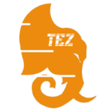



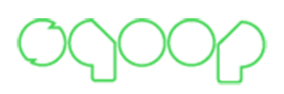

Azure HDInsight – What is it?
A standard Apache Hadoop distribution offered as a managed service on Microsoft Azure
Based on Hortonworks Data Platform (HDP)
Provisioned as clusters on Azure that can run on Windows or Linux servers
Offers capacity-on-demand, pay-as-you-go pricing model
Integrates with:
Azure Blob Storage and Azure Data Lake Store for Hadoop File System (HDFS)
Azure Portal for management and administration
Visual Studio for application development tooling
Hive
In addition to the core, HDInsight supports the Hadoop ecosystem

Slide 75
HDInsight and Hadoop ecosystem (2017)
Legend
Red =
Core Hadoop
Blue = Data processing (Hadoop)
Gray = Microsoft integration points and value adds
Orange =
Data movement
Green = Packages
Azure Infrastructure components
Pipeline/ workflow
(Oozie)
JavaScript
C#, F#, .NET
Graph
(Pegasus)
Stats processing
(RHadoop)
Machine Learning
(Mahout)
Data integration
(ODBC/SQOOP/REST)
Relational
(SQL Server)
Metadata
(HCatalog)
PDW PolyBase
Real-time processing (Storm)
NoSQL Database
(HBase)
Scripting
(Pig)
Query
(Hive)
Event-driven processing
Distributed processing
(MapReduce)
Event pipeline
(Event hub/ flume)
Business Intelligence
(Excel, Power BI, SSAS)
YARN
Distributed storage (HDFS)
Monitoring & deployment (System Center)
World's data (Azure Data Marketplace)
Azure Storage Vault (ASV)
Active Directory (Security)
HDInsight supports Mahout, HBase, Storm, Hive

Slide 76
Hortonworks Data Platform (HDP) http://hortonworks.com/
HDP delivers a single integrated Hadoop platform for enterprises
Provides a data platform for multi-workload data processing across an array of processing methods including batch and interactive to real-time
Supports key capabilities of an enterprise data platform: Governance, Security and Operations
YARN and Hadoop Distributed Filesystem (HDFS) are the core components of HDP
YARN is treated as datacenter OS and supports multiple access methods (batch, real-time, streaming, in-memory, and more) on a common data set
YARN is the architectural center of Hadoop that allows to process data simultaneously in multiple ways
Allows creating multi-tenant data analytics applications
HDP runs natively on Linux and Windows OS
HDP provides the basis for Microsoft’s HDInsight Service meaning complete portability of data is retained on-premise and in the cloud
Available in integrated hardware from Teradata
Hortonworks provides a simple starters solution Hadoop Sandbox
Hortonworks Sandbox is a single-node implementation of Hadoop based on the Hortonworks Data Platform that includes all the typical components found in a Hadoop deployment
Notes:
To add at the end
The Sandbox package also offers a number of tutorials that allow users to execute Hadoop data analysis tasks

Slide 77
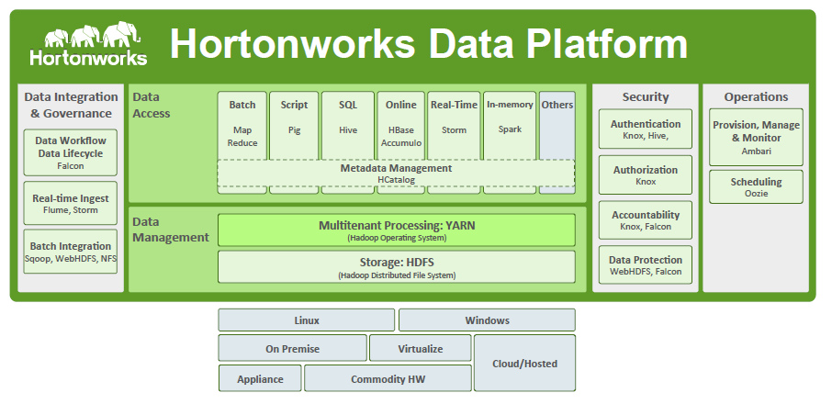
Hortonworks Data Platform Architecture [ref]
HDP includes the most recent developments of the Open Source Hadoop suite
Can run on Linux and on Windows OS
Can be deployed on premises on dedicated cluster and on cloud as a hosted application
[ref] http://hortonworks.com/hdp /

Slide 78
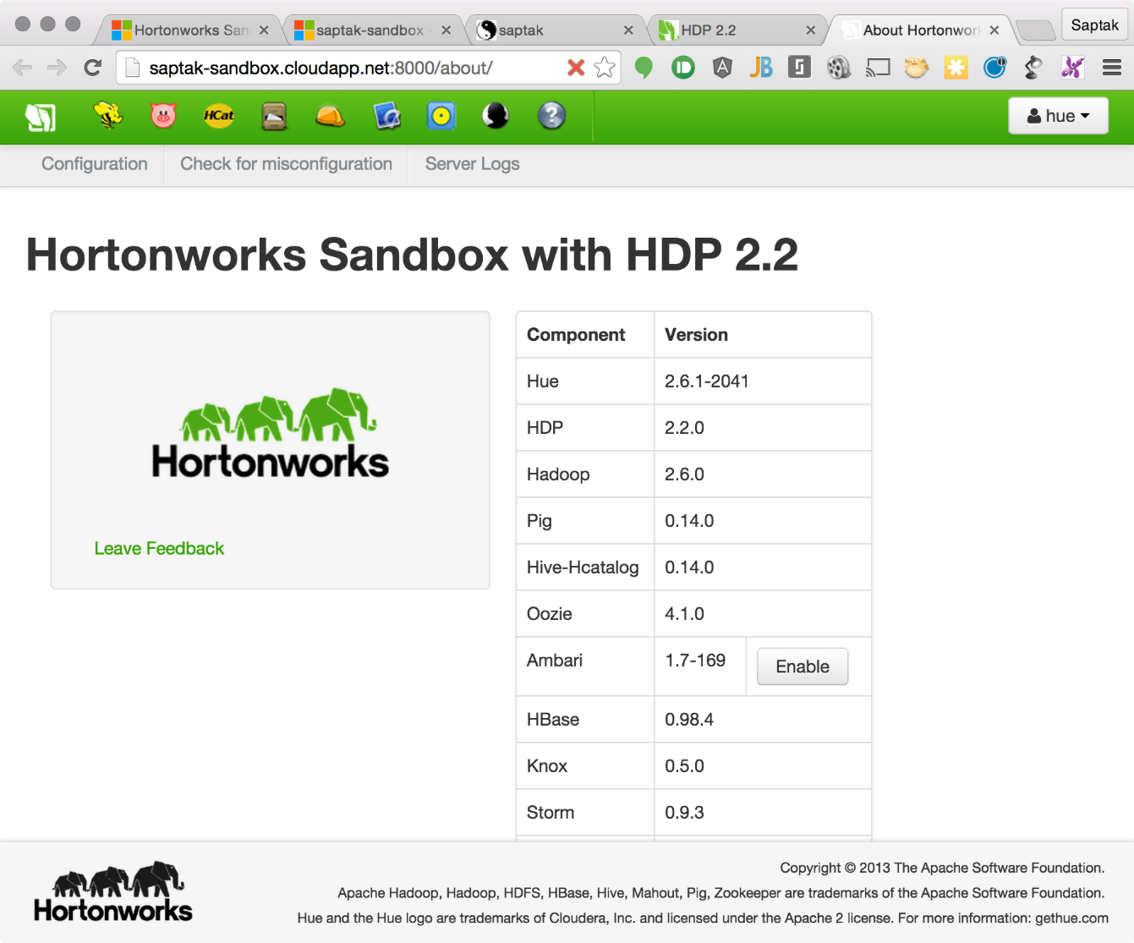
HortonWorks Sandbox VM
Simple starters solution Hadoop Sandbox
Hortonworks Sandbox is a single-node implementation of Hadoop based on the Hortonworks Data Platform
Includes all the typical components found in a Hadoop deployment

Slide 79
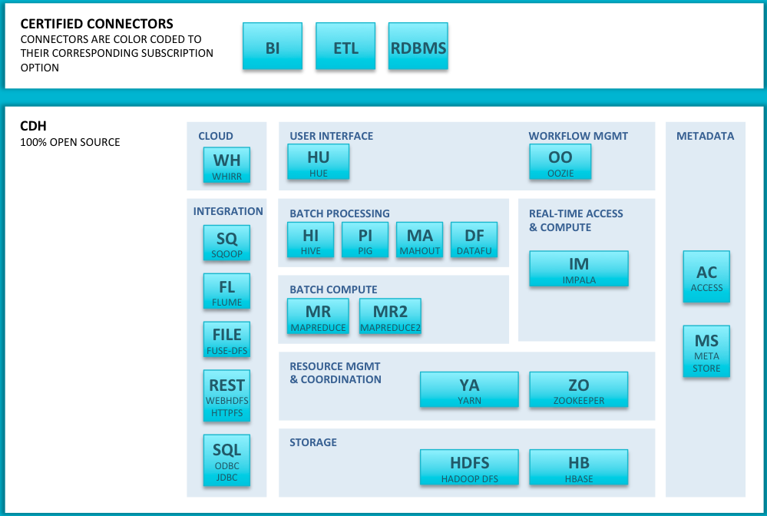
Cloudera Hadoop Cluster Architecture https://www.cloudera.com/downloads/quickstart_vms/5-13.html

Slide 80
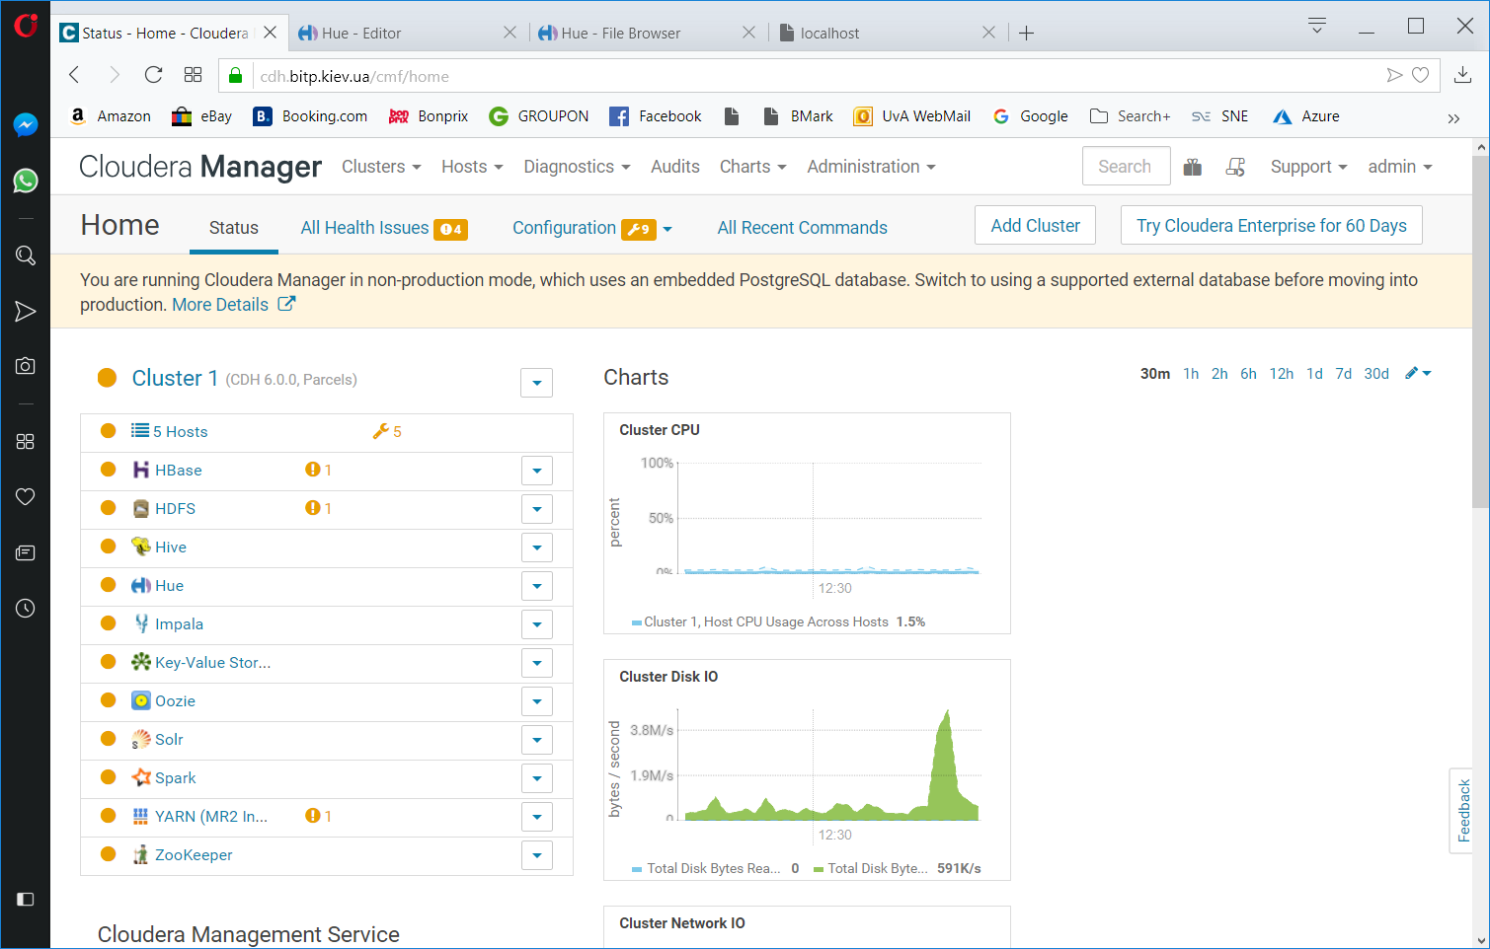
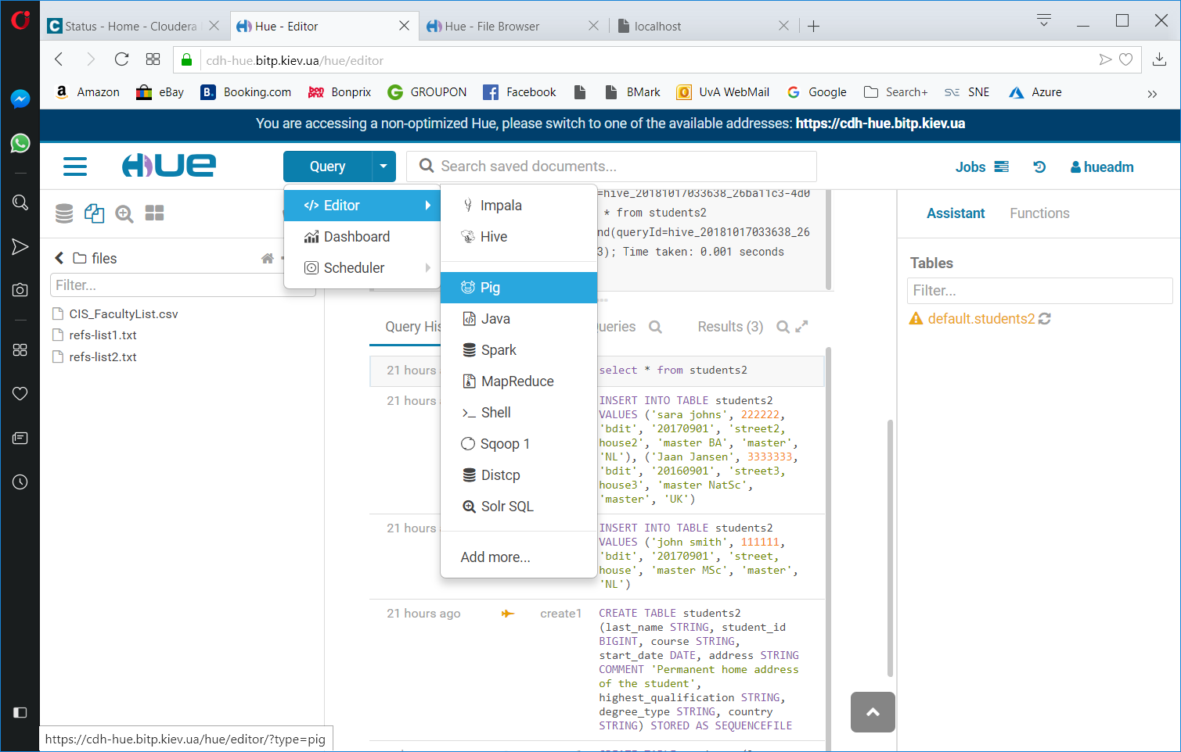
Cloudera Hadoop cluster on cloud

Slide 81
Cloudera Quickstart VM for VirtualBox https://www.cloudera.com/downloads/quickstart_vms/5-13.html
Accounts
Once you launch the VM, you are automatically logged in as the cloudera user. The account details are:
username: cloudera
password: cloudera
The cloudera account has sudo privileges in the VM. The root account password is cloudera.
The root MySQL password (and the password for other MySQL user accounts) is also cloudera.
Hue and Cloudera Manager use the same credentials.

Slide 82
Summary and take away
Cloud is a platform of choice for Big Data and Data Analytics applications and tasks
Hadoop is a standard de facto platform for Big Data Analytics
All major CSP provide variety of Big Data Analytics services: AWS, Azure, GCP
HDFS is a commonly recognised storage for Big Data and scalable data processing
Data Lakes is new model for Big Data and ELT (Extract – Load – Transfer) processes
Notes:
In this Lesson we covered
Multiple data types require different types of data stores or databases
SQL or Relational databases serve majority of current business and enterprise purposes
Abrupt data growth and advent of Big Data technologies motivates new type of databases NoSQL (Not only SQL) to serve different types of data: key-value, columnar, document, graph
CAP Theorem provides a basis for defining properties of the distributed system i.e. storage and databases such as Consistency, Availability and Partitioning tolerance
Columnar databases BigTable, HBase, Cassandra are designed to handle web scale data volume
They are specifically adopted to work with such scalable parallel processing systems as Hadoop
MongoDB is a highly scalable schema free document oriented databases where the each record can have own schema or structure that can be defined by the XML schema or JSON script
Neo4j is an example of the Graph databases that have growing use for social network and business relations analysis

Slide 83
Additional Materials
DevOps and DataOps
Data Markets and Data as economic goods

Slide 84
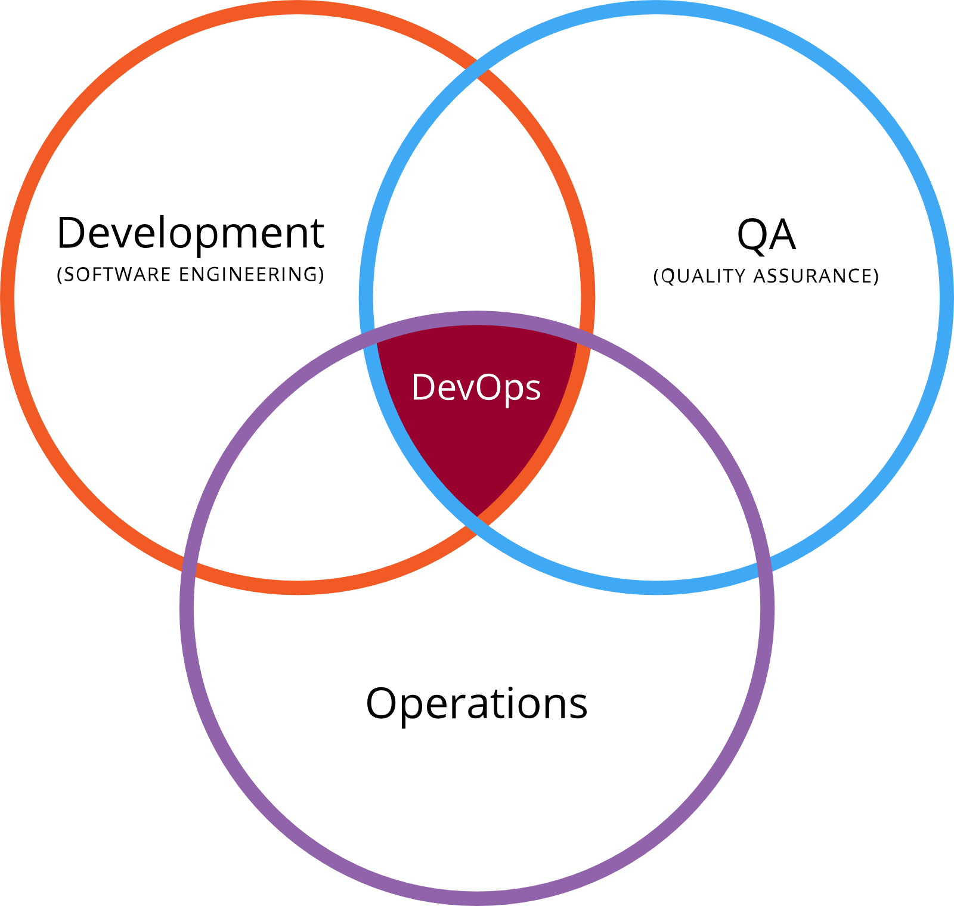
DevOps
DevOps is the practice of operations and development engineers participating together in the entire service lifecycle, from design through the development process to production support.
DevOps Essentials
Better Software, Faster time to market
Movement Comes from Open Source
Synergy of Development and Operations
Covers the *entire* Application LifeCycle

Slide 85
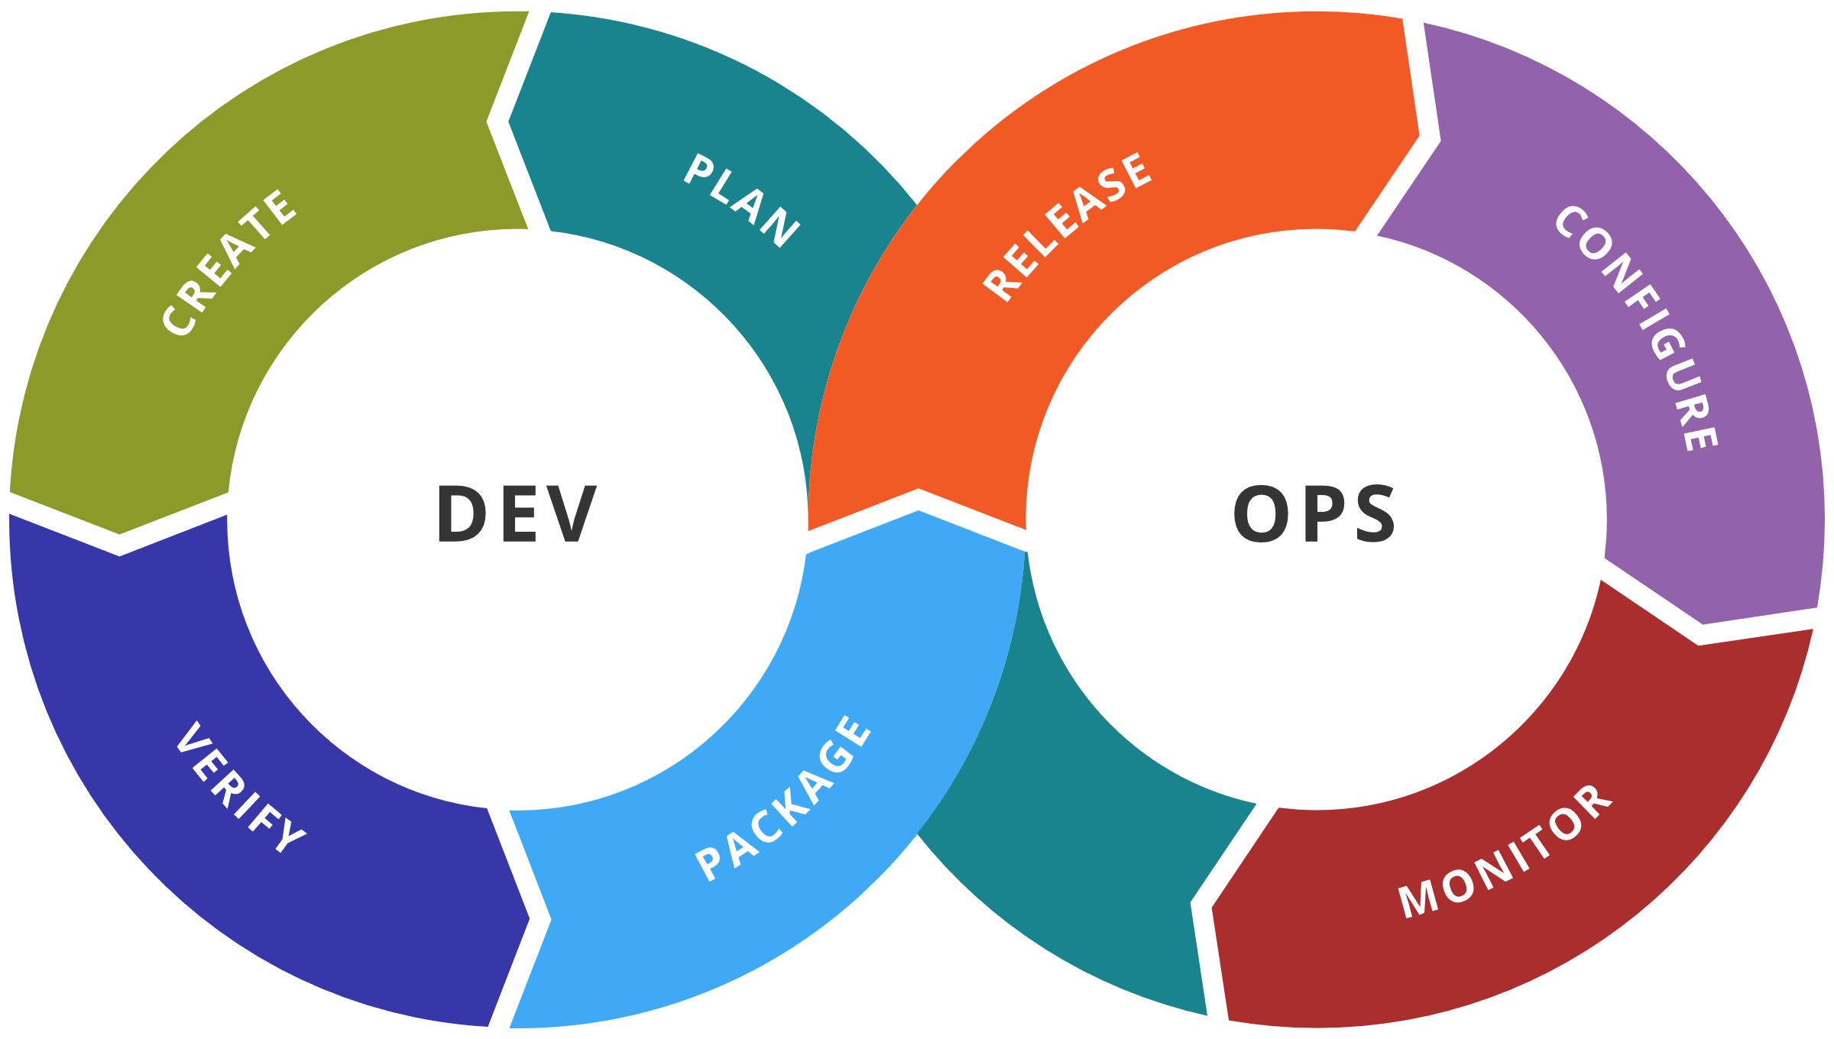
DevOps Toolchain
DevOps is a cultural shift and collaboration between development, operations and testing, enabled by DevOps toolchain
Code — Code development and review, version control tools, code merging
Build — Continuous integration tools, build status
Test — Test and results determine performance
Package — Artifact repository, application pre-deployment staging
Release — Change management, release approvals, release automation
Configure — Infrastructure configuration and management, Infrastructure as Code tools
Monitor — Applications performance monitoring, end–user experience

Slide 86


Cloud-powered Services Development Lifecycle
Configuration Management & Orchestration
Dev
Test/QA
Staging
Prod
2-tier app
with test DB
2-tier app with
production data
All in one instance
2-tier app with
production data
Multi-AZ and HA
Amazon CloudFormation + Chef (or Puppet)
Easily creates test environment close to real
Powered by cloud deployment automation tools
To enable configuration Management and Orchestration, Deployment automation
Continuous development – test – integration
CloudFormation Template, Configuration Template, Bootstrap Template
Can be used with Puppet and Chef, two configuration and deployment management systems for clouds
[ref] Building Powerful Web Applications in the AWS Cloud” by Louis Columbus http://softwarestrategiesblog.com/2011/03/10/building-powerful-web-applications-in-the-aws-cloud/
Notes:
The Cloud-powered Software Development Lifecycle is one of Continuous integration, as the slide illustrates
Allows testing close to the real environment
CloudFormation helps in automating deployment, modification, and making snapshot of working configuration/stack

Slide 87
Azure DevOps Services (since 10 Sept 2018, former VSTS)
Azure DevOps Services is a cloud service for collaborating on code development.
Azure Pipelines
CI/CD that works with any language, platform, and cloud.
Azure Repos
Unlimited cloud-hosted private Git and TFVC repos for your project.
Azure Boards
Work tracking with Kanban boards, backlogs, team dashboards, and custom reporting.
Azure Test Plans
All-in-one planned and exploratory testing solution.
Azure Artifacts
Maven, npm, and NuGet package feeds from public and private sources.
Built-in wiki for sharing information with DevOps team

Slide 88
Azure DevOps Processes
Continuous integration (CI)
Take advantage of continuous integration to improve software development quality and speed. When you use Azure DevOps or Jenkins to build apps in the cloud and deploy to Azure, each time you commit code, it’s automatically built and tested—so bugs are detected faster.
Continuous delivery (CD)
Ensure that code and infrastructure are always in a production-deployable state, with continuous delivery. By combining continuous integration and infrastructure as code (IaC), you’ll achieve identical deployments and the confidence you need to manually deploy to production at any time.
Continuous deployment with CI/CD
With continuous deployment, you can automate the entire process from code commit to production if your CI/CD tests are successful. Using CI/CD practices, paired with monitoring tools, you’ll be able to safely deliver features to your customers as soon as they’re ready.

Slide 89
DataOps
DataOps (data operations) is an emerging discipline that brings together DevOps teams with data engineer and data scientist roles to provide the tools, processes and organizational structures to support the data-focused enterprise.
DataOps is a new approach to the end-to-end data lifecycle, which applies new processes and methodologies to data analytics.
Agile software development helps deliver new analytics faster and with higher quality.
DevOps automates the deployment of new analytics and data.
Statistical process controls, used in lean manufacturing, test and monitor the quality of data flowing through the data-analytics pipeline.

Slide 90
Data Exchange and Data Markets
Next EU Horizon2020 Programme Call on Data Markets Infrastructure http://ec.europa.eu/research/participants/portal/desktop/en/opportunities/h2020/topics/ict-13-2018-2019.html
BoF on Data property as economic goods at IDW2018 & RDA12 Plenary on 5-8 Nov 2018 in Gaborone Botswana https://www.rd-alliance.org/bof-data-properties-economic-goods-rda-12th-plenary-meeting

Slide 91
Data Exchange and Data Markets
IoT is considered as a key use case and a facilitator for Data Markets
Potentially many consumers for centrally or locally operated IoT infrastructure
IoT networks create valuable data that can be used for multiple purpose
IoT data can be exchanged and traded
Open and Public data
Current trading models are simple and in most cases are free or by subscription
Making data economical goods would require new operational models, infrastructure and tools

Slide 92
Modern data architecture vs Data Market
Characteristics of modern data architecture
Customer-centric
Automated
Smart
Adaptable, Agile
Cloud based, Elastic
Collaborative
Governed
Secure, Trusted
Characteristics of emerging data markets
Customer-centric
Automated
Smart
Regional/sectoral specialised
Cloud powered/integrated
Collaborative
Governed
Secure, Trusted
Auditable
Transparent
Commoditised/Monetised
Combining data and algorithms (as part of containers)

Slide 93
Data Properties as Economic Goods
STREAM data principles for industrial and commoditised data
[S] Sovereign
[T] Trusted
[R] Reusable
[E] Exchangeable
[A] Actionable
[M] Measurable
Other data properties: Important to commoditise data
Quality, Valuable, Auditable/Trackable, Brandable, Authentic
Interoperable, Findable, Accessible, not-Rival, Composable
Ownership and IPR
Leverages FAIR principles for research data
Findable – Accessible – Interoperable - Reusable

Slide 94
Data Market Architecture components
Data Source (producer/seller/publisher) – Supply side
Data Target (consumer, buyer, subscriber) – Demand side
Data Broker
Data/Value Broker
Trust Broker or Trusted Introducer
Directory or Catalog service
Including data (quality) ranking
Including API link or repository
Data Exchange
Infrastructure component vs peer-to-peer customer network
Provenance and transactions control issue
Data Storage/Cache Data Delivery Network
Data Lake (HDFS based and SQL/NoSQL)
Caching for traffic optimisation in DDN
Open/Public Data access and storage
Can be stored to offer as part of DM storage
Facilitate quality of data analytics
Data Transfer vs Data Access
Scenario: App container vs Data container
Container security using Intel TXT or SGX technology
(Optional) Secure data processing
Used for data quality inspection (e.g. P.I.D., or IP), auditing, composition
Data preparation/conditioning
Re-using experience of Internet eXchange, Cloud eXchange and Financial Exchanges

Slide 95
International Data Space Association
Started 2016 as Industrial Data Space initiative (supported by German project)
Re-defined as International Data Space Association (IDSA)
Published International Data Space Architecture Version 2.0 (2018)
Whitepaper and use cases
Associated H2020 projects
Boost4.0 – Big Data for Factories (20 Mln (100 Mln private), 3yrs, 50 partners, 16 countries)
MIDIH – Manufacturing Industry Digital Innovation Hub (22 partners, 12 countries)
Services: technological, business, skills building
Open calls
Close cooperation with FIWARE Foundation (cloud like infrastructure resulted from Future Internet program)
Positions itself against IoT and Open-Data solutions in the areas of smart cities, Industry 4.0 and agriculture
Ongoing active outreach developments
Data Sovereignty and Secure Data Exchange model
Data Markets
Trusted platforms

Slide 96
General Structure of IDS Architecture
Specification defines functionalities by layers
Details are sufficient to define processes, functional components and API

Slide 97
Cloud based IDS infrastructure for Data Exchange and Trading
IDS Connector is the main functional component
No specifically defined common infrastructure services

